Slide 1


Noida Institute of Engineering and Technology, Greater Noida
Wavelets and Applications and Aptitude IV
Unit: V
Subject Name: Mathematics-IV
Subject Code: AAS0402
Dr. Kunti Mishra
NIET, Gr Noida
Department of
Mathematics
B Tech 4th Sem

Slide 2

Brief Introduction of Faculty
Dr. Kunti Mishra
Assistant Professor
Department of Mathematics
Qualifications :
M.Sc.(Maths), M. Tech.(Gold Medalist) in Applied and Computational Mathematics, Ph.D
Ph.D. Thesis : Some Investigations in Fractal Theory
Total Number of Research Papers:15
Area of Interests: Fixed Point Theory, Fractals
Teaching Experience: 9 years

Slide 3
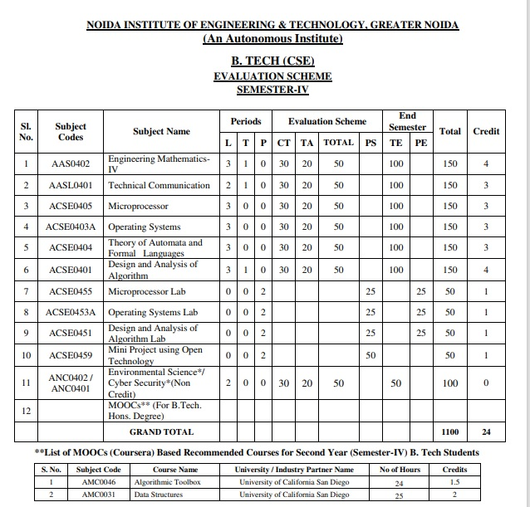
Evaluation Scheme

Slide 4
Syllabus
Unit-I (Statistical Techniques-I)
Introduction: Measures of central tendency: Mean, Median, Mode, Moment, Skewness, Kurtosis, Curve Fitting ,Method of least squares, Fitting of straight lines, Fitting of second degree parabola, Exponential curves ,Correlation and Rank correlation, Linear regression, nonlinear regression and multiple linear regression
Unit-II (Statistical Techniques-II)
Testing a Hypothesis, Null hypothesis, Alternative hypothesis, Level of significance, Confidence limits, p-value, Test of significance of difference of means, Z-test, t-test and Chi-square test, F-test, ANOVA: One way and Two way
Statistical Quality Control (SQC), Control Charts, Control Charts for variables (Mean and Range Charts), Control Charts for Variables ( p, np and C charts).

Slide 5
Syllabus
Unit III (Probability and Random Variable)
Random Variable: Definition of a Random Variable, Discrete Random Variable, Continuous Random Variable, Probability mass function, Probability Density Function, Distribution functions.
Multiple Random Variables: Joint density and distribution Function, Properties of Joint Distribution function, Marginal density Functions, Conditional Distribution and Density, Statistical Independence, Central Limit Theorem (Proof not expected).
Unit IV (Expectations and Probability Distribution)
Operation on One Random Variable – Expectations: Introduction, Expected Value of a Random Variable, Mean, Variance, Moment Generating Function, Binomial, Poisson, Normal, Exponential distribution.

Slide 6
Syllabus
Unit V (Wavelets and its applications and Aptitude-IV)
Wavelet Transform, wavelet series. Basic wavelets (Haar/Shannon/Daubechies), orthogonal wavelets, multi-resolution analysis, reconstruction of wavelets and applications.
Number System, Permutation & Combination, Probability, Function, Data Interpretation, Syllogism.

Slide 7
Branch wise Application
Helps to improve Research skill
Helpful in Competitive Exams

Slide 8

Course Objective
The objective of this course is to familiarize the students with statistical techniques. It aims to present the students with standard concepts and tools at an intermediate to superior level that will provide them way towards undertaking a variety of problems in the discipline.
The students will:
Understand the concept of correlation, moments, skewness and kurtosis and curve fitting.
Apply the concept of hypothesis testing and statistical quality control to create control charts.
Remember the concept of probability to evaluate probability distributions.
Understand the concept of Mathematical Expectations and Probability Distribution.
Remember the concept of Wavelet Transform and solve the problems of Number System, Permutation & Combination, Probability, Function, Data Interpretation, Syllogism.

Slide 9
Course Outcome
CO1: Understand the concept of correlation, moments, skewness, kurtosis and curve fitting.
CO2: Apply the concept of hypothesis testing and statistical quality control to create control charts.
CO3: Remember the concept of probability to evaluate probability distributions
CO4: Understand the concept of Mathematical Expectations and Probability Distribution
CO5: Remember the concept of Wavelet Transform and Solve the problems of Number System, Permutation & Combination, Probability, Function, Data Interpretation, Syllogism.

Slide 10
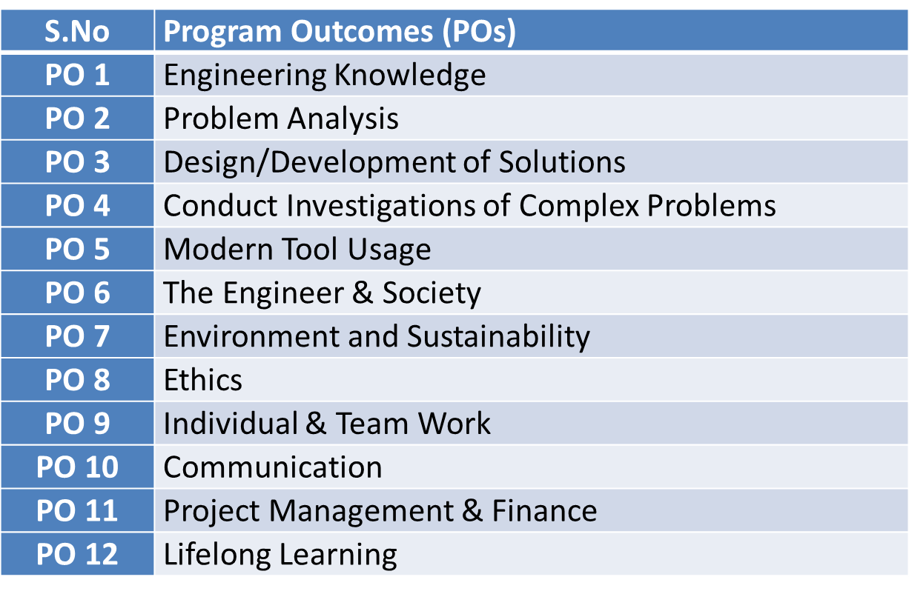
Program Outcomes

Slide 11
CO-PO Mapping(CO5)
Sr. No | Course Outcome | PO1 | PO2 | PO3 | PO4 | PO5 | PO6 | PO7 | PO8 | PO9 | PO10 | PO11 | PO12
1 | CO1 | H | H | H | H | L | L | L | L | L | L | L | M
2 | CO2 | H | H | H | H | L | L | L | L | L | L | M | M
3 | CO3 | H | H | H | H | L | L | L | L | L | L | M | M
4 | CO4 | H | H | H | H | L | L | L | L | L | L | L | M
5 | CO5 | H | H | H | H | L | L | L | L | L | L | M | M
*L= Low *M= Medium *H= High

Slide 12
PSO
PSO | Program Specific Outcomes(PSOs)
PSO1 | The ability to identify, analyze real world problems and design their ethical solutions using artificial intelligence, robotics, virtual/augmented reality, data analytics, block chain technology, and cloud computing
PSO2 | The ability to design and develop the hardware sensor devices and related interfacing software systems for solving complex engineering problems.
PSO3 | The ability to understand inter disciplinary computing techniques and to apply them in the design of advanced computing.
PSO4 | The ability to conduct investigation of complex problem with the help of technical, managerial, leadership qualities, and modern engineering tools provided by industry sponsored laboratories.

Slide 13
CO-PSO Mapping(CO5)
CO | PSO1 | PSO2 | PSO3 | PSO4
CO.1 | H | L | M | L
CO.2 | L | M | L | M
CO.3 | M | M | M | M
CO.4 | H | M | M | M
CO.5 | H | M | M | M
*L= Low *M= Medium *H= High

Slide 14
Program Educational Objectives(PEOs)
PEO-1: To have an excellent scientific and engineering breadth so as to comprehend, analyze, design and provide sustainable solutions for real-life problems using state-of-the-art technologies.
PEO-2: To have a successful career in industries, to pursue higher studies or to support entrepreneurial endeavors and to face the global challenges.
PEO-3: To have an effective communication skills, professional attitude, ethical values and a desire to learn specific knowledge in emerging trends, technologies for research, innovation and product development and contribution to society.
PEO-4: To have life-long learning for up-skilling and re-skilling for successful professional career as engineer, scientist, entrepreneur and bureaucrat for betterment of society.

Slide 15
End Semester Question Paper Template
Link:100 Marks Question Paper Template.docx

Slide 16
Result Analysis
Branch | Semester | Sections | No. of enrolled Students | No. Passed Students | % Passed
CS | IV | A | 67 | 65 | 92%
IOT | IV | A | 49 | 45 | 91.83%

Slide 17
Prerequisite and Recap(CO5)
Knowledge of Mathematics I ,II and III of B. Tech or equivalent.

Slide 18
Course Objective(CO5)
In first four modules, we will discuss Statistics.
In 5th module we will discuss wavelet Transform & aptitude part.

Slide 19
Unit Content(CO5)
Wavelet Transform
Wavelet series
Basic wavelets (Haar/Shannon/Daubechies)
orthogonal wavelets
multi-resolution analysis
reconstruction of wavelets and applications
Number System
Permutation & Combination
Probability
Function
Data Interpretation
Syllogism

Slide 20
Unit Objective(CO5)
The objective of this unit is to familiarize the engineers with wavelet Transform and Aptitude.

Slide 21
Topic Objective (CO5)
Discrete wavelet Transform
Continuous wavelet Transform

Slide 22
Wavelet Transform(CO5)
A major disadvantage of the Fourier Transform is it captures global frequency information, meaning frequencies that persist over an entire signal. This kind of signal decomposition may not serve all applications well, for example Electrocardiography (ECG) where signals have short intervals of characteristic oscillation. An alternative approach is the Wavelet Transform, which decomposes a function into a set of wavelets.

Slide 23
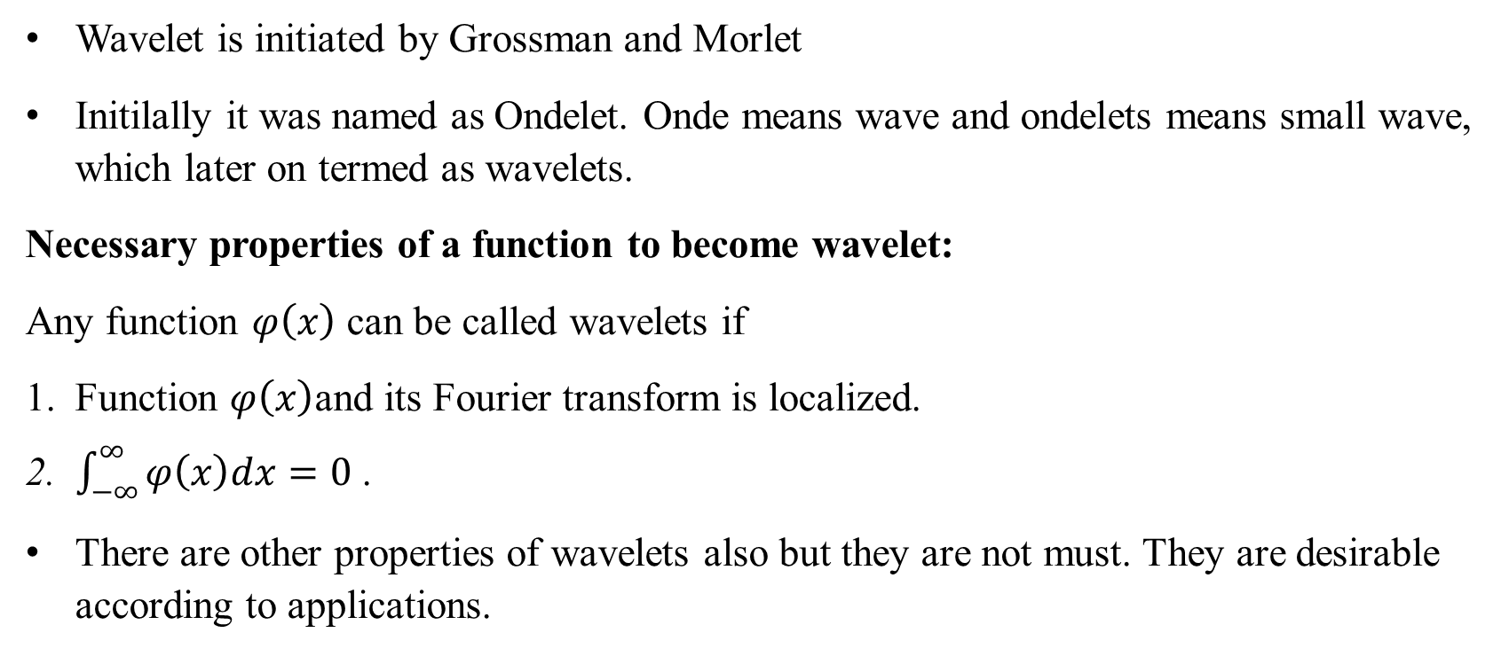
Wavelet Transform(CO5)
Wavelet is initiated by Grossman and Morlet
Initilally it was named as Ondelet. Onde means wave and ondelets means small wave, which later on termed as wavelets.
Necessary properties of a function to become wavelet:
Any function $φ\left(x\right)$ can be called wavelets if
Function $φ\left(x\right)$and its Fourier transform is localized.
$\int_{−∞}^{∞}{φ\left(x\right)dx=0}$ .
There are other properties of wavelets also but they are not must. They are desirable according to applications.
Notes:
Unit contains :Wavelet Transform, wavelet series. Basic wavelets (Haar/Shannon/Daubechies), orthogonal wavelets, multi-resolution analysis, reconstruction of wavelets and applications.
Number System, Permutation & Combination, Probability, Function, Data Interpretation, Syllogism.

Slide 24
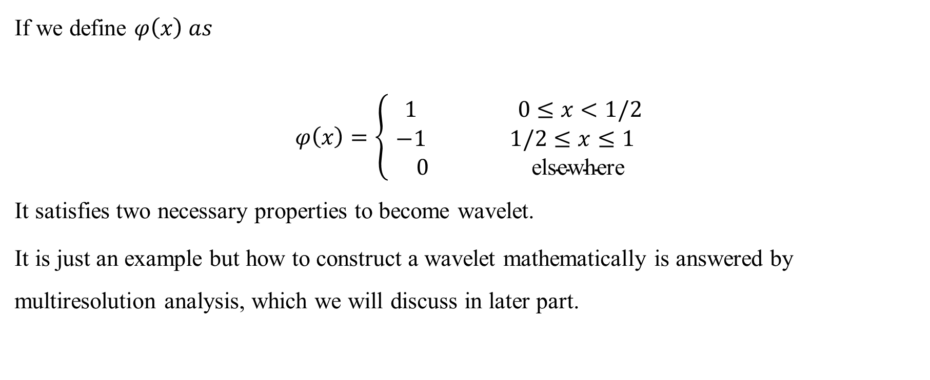
Wavelet Transform(CO5)
If we define $φ\left(x\right) as$
$$φ\left(x\right)=\left\{\begin{aligned} 1 0≤x<1/2 \\ −1 1/2≤x≤1 \\ 0 \text{elsewhere}\end{aligned}\right.$$
It satisfies two necessary properties to become wavelet.
It is just an example but how to construct a wavelet mathematically is answered by multiresolution analysis, which we will discuss in later part.
Notes:
Unit contains :Wavelet Transform, wavelet series. Basic wavelets (Haar/Shannon/Daubechies), orthogonal wavelets, multi-resolution analysis, reconstruction of wavelets and applications.
Number System, Permutation & Combination, Probability, Function, Data Interpretation, Syllogism.

Slide 25
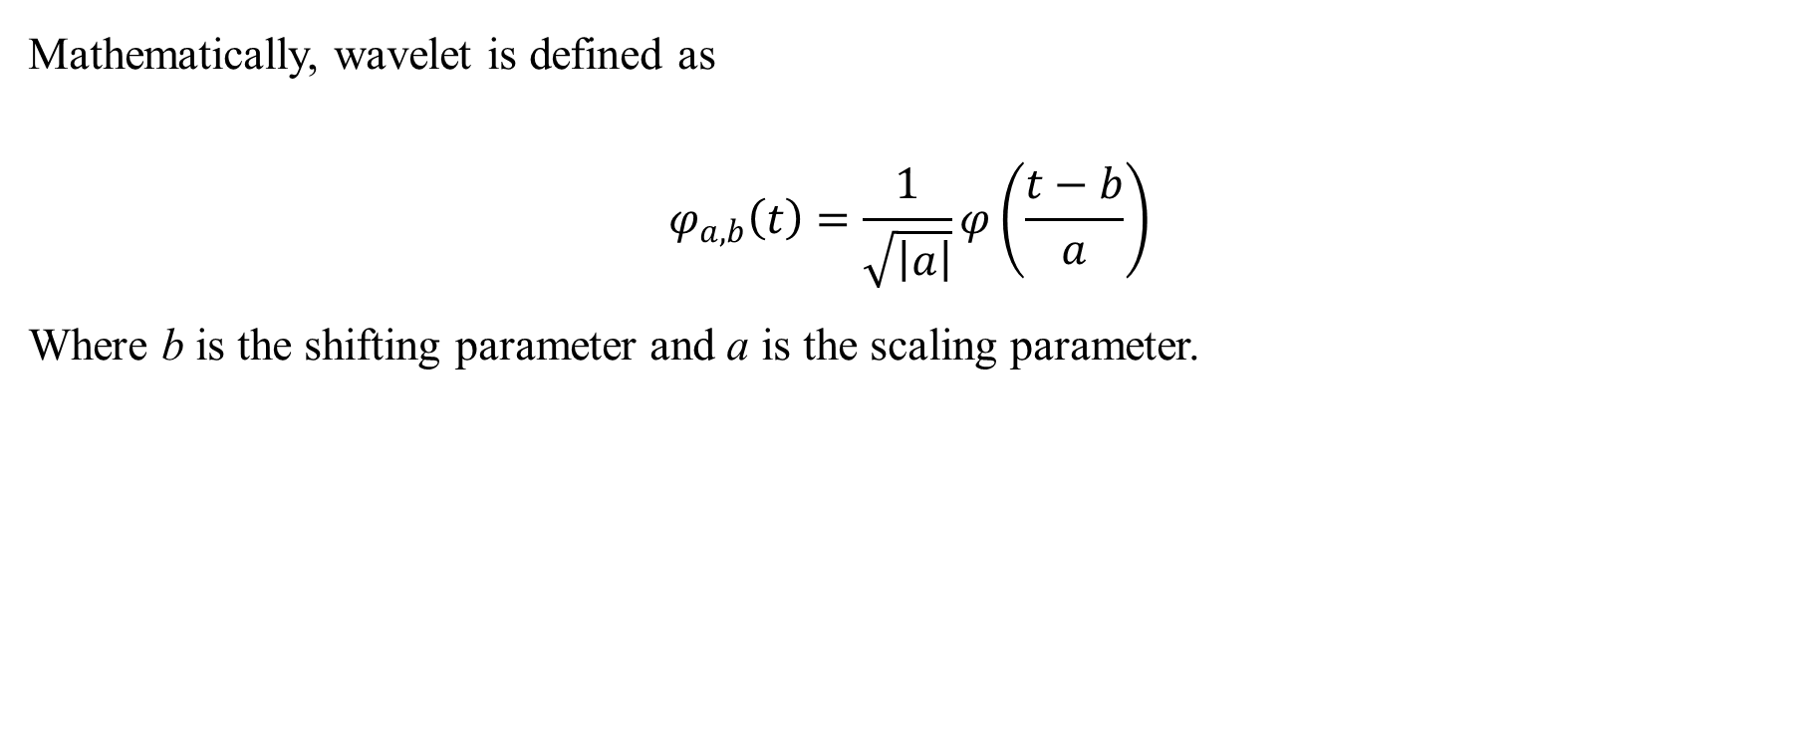
Wavelet Transform(CO5)
Mathematically, wavelet is defined as
$$φ_{a,b}\left(t\right)=\frac{1}{\sqrt{\left|a\right|}}φ\left(\frac{t−b}{a}\right)$$
Where b is the shifting parameter and a is the scaling parameter.
Notes:
Unit contains :Wavelet Transform, wavelet series. Basic wavelets (Haar/Shannon/Daubechies), orthogonal wavelets, multi-resolution analysis, reconstruction of wavelets and applications.
Number System, Permutation & Combination, Probability, Function, Data Interpretation, Syllogism.

Slide 26
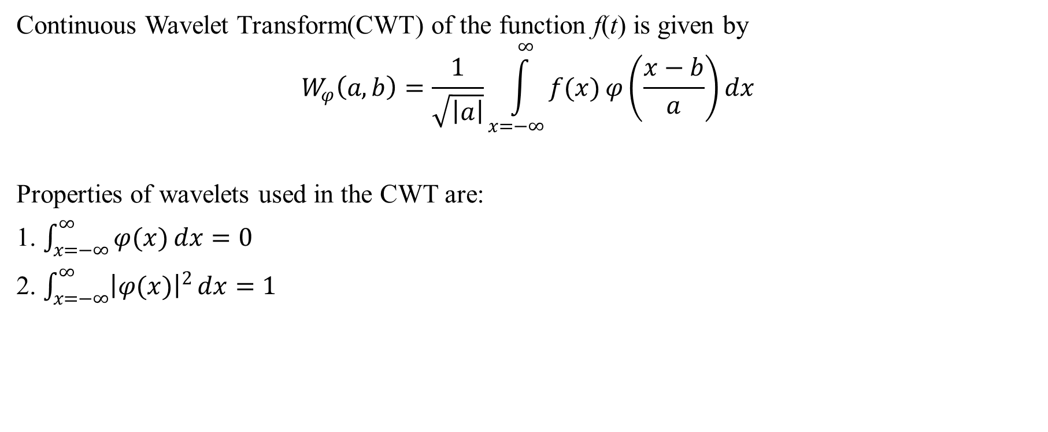
Wavelet Transform(CO5)
Continuous Wavelet Transform(CWT) of the function f(t) is given by
$$W_{φ}\left(a,b\right)=\frac{1}{\sqrt{\left|a\right|}}\int_{x=−∞}^{∞}{f(x)}φ\left(\frac{x−b}{a}\right)dx$$
Properties of wavelets used in the CWT are:
1. $\int_{x=−∞}^{∞}{φ(x)}dx=0$
2. $\int_{x=−∞}^{∞}{{\left|φ(x)\right|}^{2}}dx=1$

Slide 27
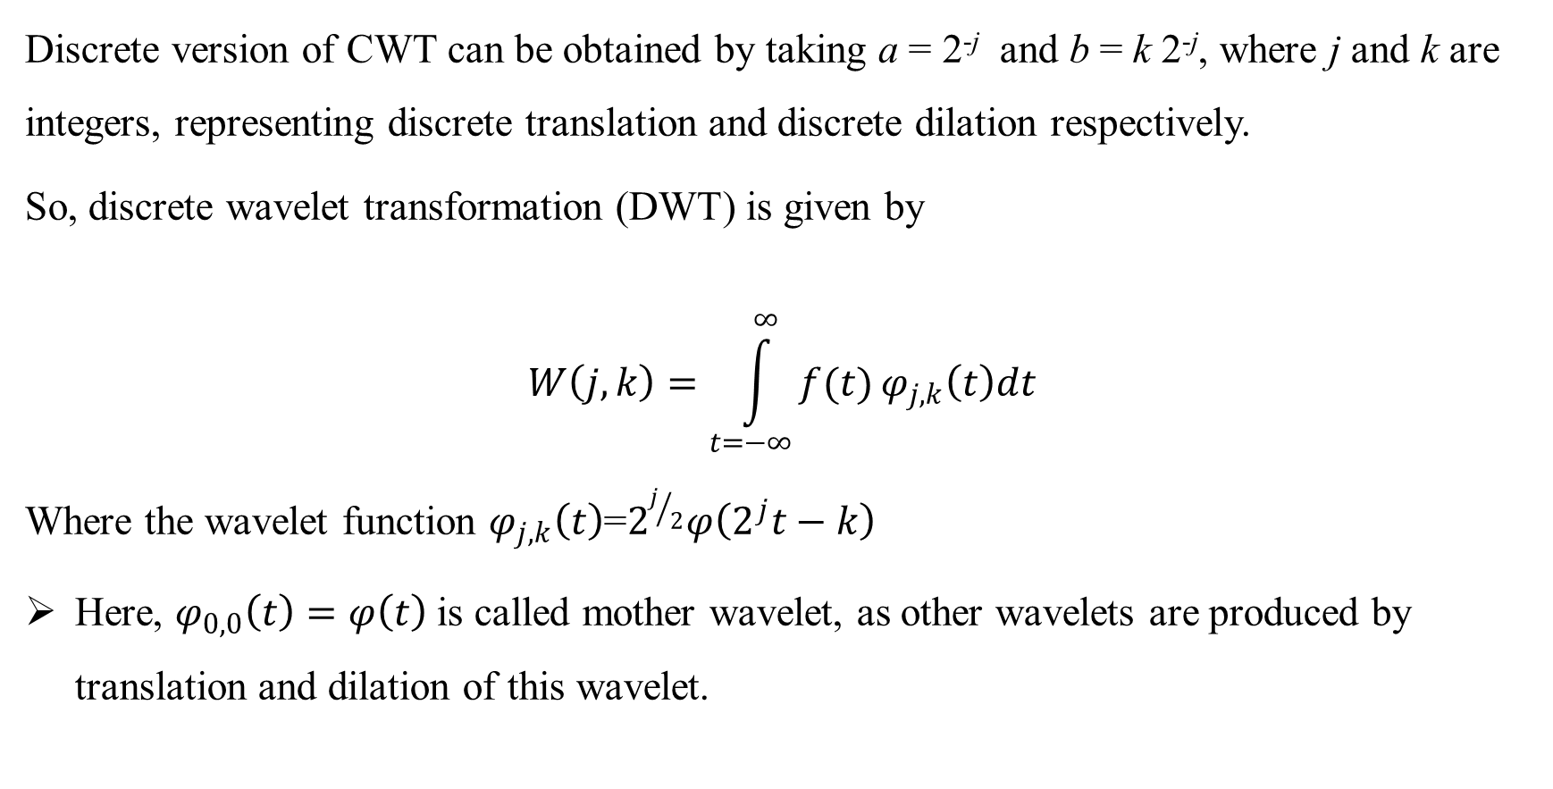
Wavelet Transform(CO5)
Discrete version of CWT can be obtained by taking a = 2^{-j} and b = k 2^{-j}, where j and k are integers, representing discrete translation and discrete dilation respectively.
So, discrete wavelet transformation (DWT) is given by
$$W\left(j,k\right)=\int_{t=−∞}^{∞}{f(t)}φ_{j,k}\left(t\right)dt$$
Where the wavelet function $φ_{j,k}\left(t\right)$=$2^{j/2}φ\left(2^{j}t−k\right)$
Here, $φ_{0,0}\left(t\right)=φ\left(t\right)$ is called mother wavelet, as other wavelets are produced by translation and dilation of this wavelet.

Slide 28
Wavelet Transform(CO5)
For DWT, we basically deal with two types of functions:
Scaling Function
Wavelet Function.
There are some specific methods to construct scaling function and wavelet function mathematically, about which we will discuss in later slides.
Wavelet function we have defined earlier, so we need to know about scaling function. We are going to discuss scaling function given by Haar.

Slide 29
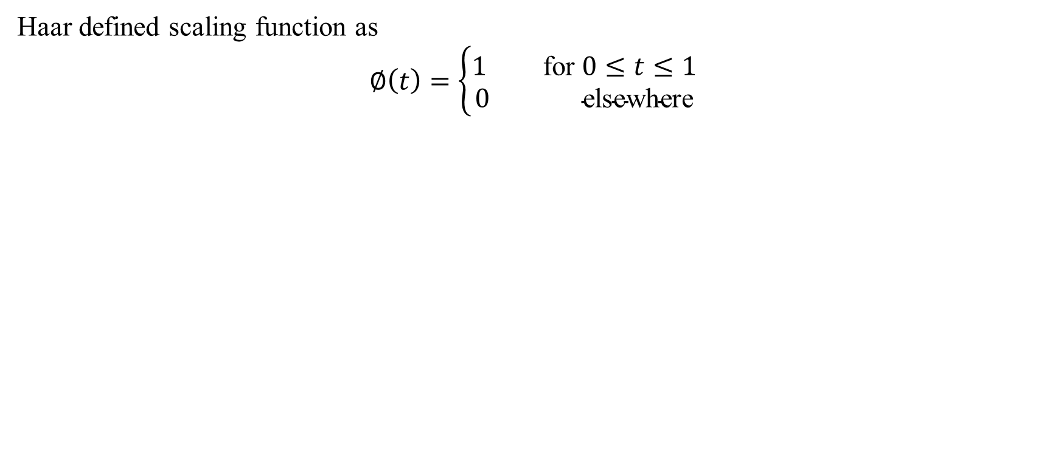
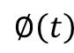
Wavelet Transform(CO5)
Haar defined scaling function as
$$∅\left(t\right)=\left\{\begin{aligned}1 \text{for} 0≤t≤1 \\ 0 \text{elsewhere}\end{aligned}\right.$$
$$∅\left(t\right)$$
0
1
t

Slide 30
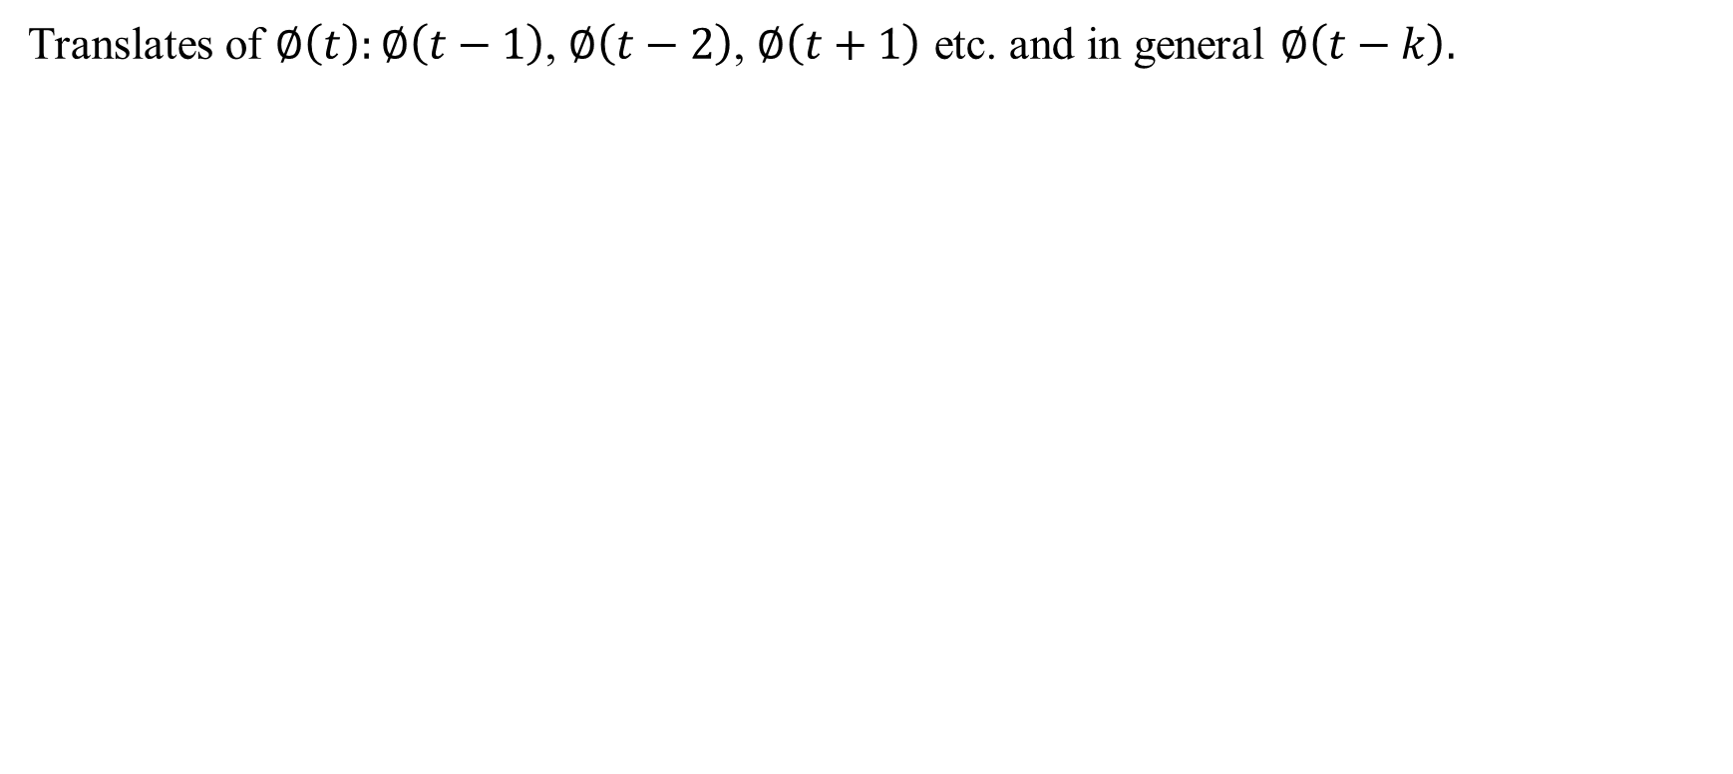
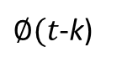
Wavelet Transform(CO5)
Translates of $∅\left(t\right):∅\left(t−1\right)$, $∅\left(t−2\right)$, $∅\left(t+1\right)$ etc. and in general $∅\left(t−k\right).$
$∅(t$-k)
0
k
k+1
t

Slide 31
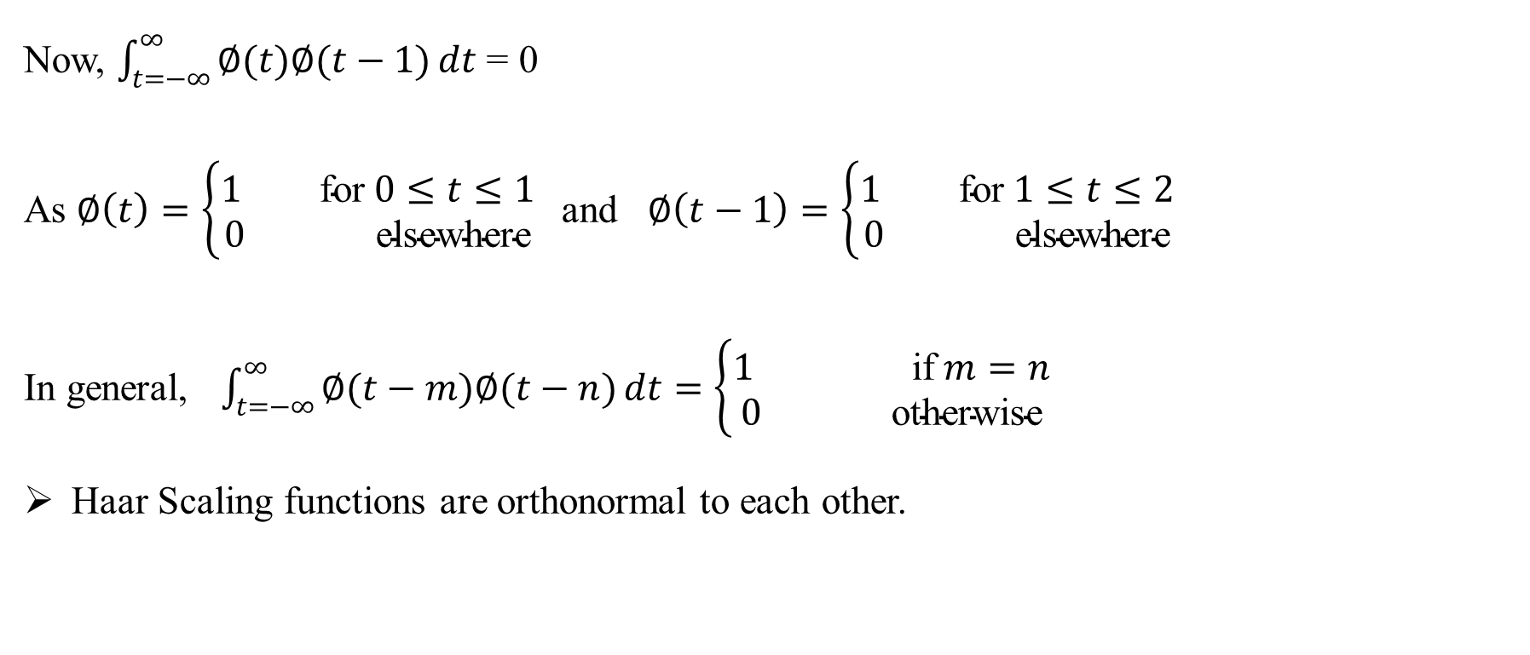
Wavelet Transform(CO5)
Now, $\int_{t=−∞}^{∞}{∅(t)∅(t−1)}dt$ = 0
As $∅\left(t\right)=\left\{\begin{aligned}1 \text{for} 0≤t≤1 \\ 0 \text{elsewhere}\end{aligned}\right.$and $∅\left(t−1\right)=\left\{\begin{aligned}1 \text{for} 1≤t≤2 \\ 0 \text{elsewhere}\end{aligned}\right.$
In general, $\int_{t=−∞}^{∞}{∅(t−m)∅(t−n)}dt=\left\{\begin{aligned}1 \text{if} m=n \\ 0 \text{otherwise}\end{aligned}\right.$
Haar Scaling functions are orthonormal to each other.

Slide 32
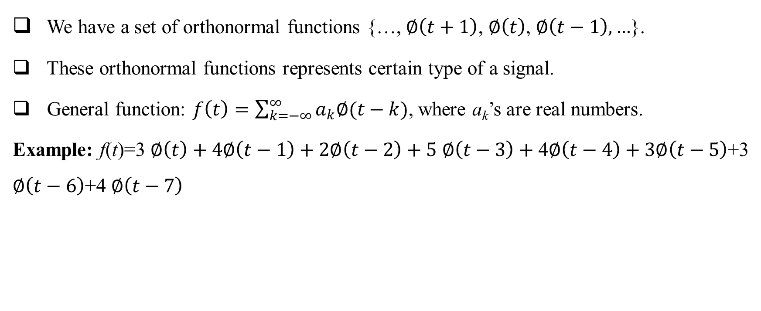
Wavelet Transform(CO5)
We have a set of orthonormal functions {…, $∅\left(t+1\right)$, $∅\left(t\right)$, $∅\left(t−1\right), …$}.
These orthonormal functions represents certain type of a signal.
General function: $f\left(t\right)=\sum_{k=−∞}^{∞}{a_{k}∅(t−k)}$, where a_{k}’s are real numbers.
Example: f(t)=3 $∅\left(t\right)+4∅\left(t−1\right)+2∅\left(t−2\right)+5$ $∅\left(t−3\right)+$ 4$∅\left(t−4\right)+3∅\left(t−5\right)$+3 $∅\left(t−6\right)$+4 $∅\left(t−7\right)$

Slide 33
Prerequisite And Recap (CO5)
In previous lectures we have discussed-
Discrete wavelet Transform
Continuous wavelet Transform

Slide 34
Daily Quiz(CO5)
Describe about discrete wavelet transform and continuous wavelet Transform.
Prove that translates of Haar scaling function are orthonormal to each other.

Slide 35
Topic Objective(CO5)
Concept of nested space
Multiresolution analysis

Slide 36

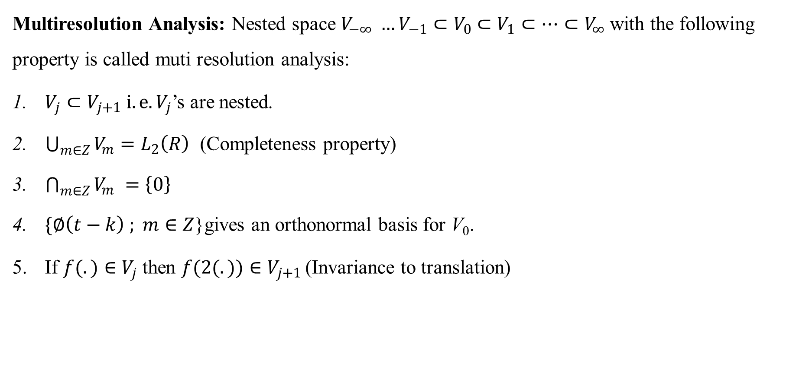
Multi Resolution Analysis(CO5)
Multiresolution Analysis: Nested space $V_{−∞} {…V}_{−1}⊂V_{0}$ $⊂V_{1}$ $⊂…{⊂V}_{∞}$ with the following property is called muti resolution analysis:
$V_{j}⊂V_{j+1} i. e.V_{j}$’s are nested.
$\bigcup_{m∈Z}{V_{m}}=L_{2}\left(R\right)$ (Completeness property)
$\bigcap_{m∈Z}{V_{m}} =\left\{0\right\}$
$\{∅\left(t−k\right) ; m∈Z$}gives an orthonormal basis for V₀.
If $f(.)∈$ $V_{j}$ then $f(2(.))∈$ $V_{j+1 }$(Invariance to translation)

Slide 37
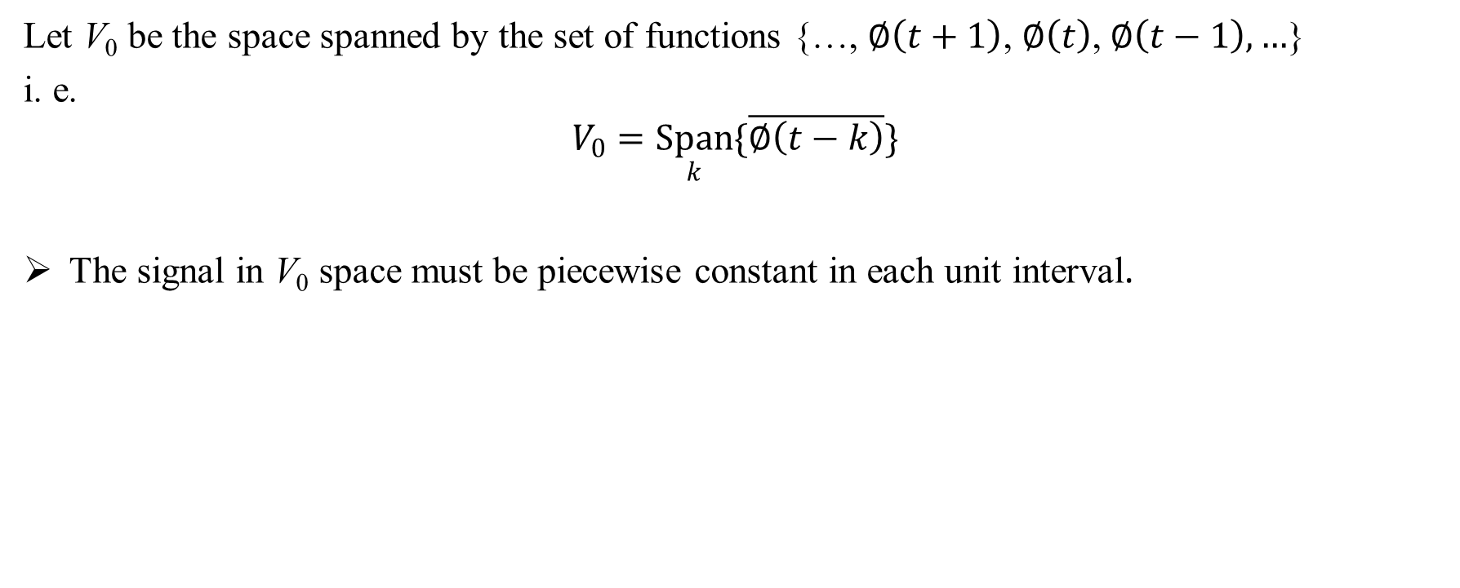
Multi Resolution Analysis(CO5)
Let V₀ be the space spanned by the set of functions {…, $∅\left(t+1\right)$, $∅\left(t\right)$, $∅\left(t−1\right), …$}
i. e.
$$V_{0}=\underset{k}{Span}{\{\overline{∅\left(t−k\right)}\}}$$
The signal in V₀ space must be piecewise constant in each unit interval.

Slide 38
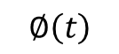
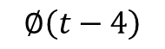
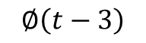
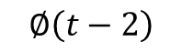
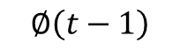

Multi Resolution Analysis(CO5)
f(t)
1
$$∅\left(t\right)$$
$$∅\left(t−1\right)$$
$$∅\left(t−2\right)$$
$$∅\left(t−3\right)$$
$$∅\left(t−4\right)$$
3
t
$$0$$
1
2
4
5
A signal f(t) which is element of space V₀

Slide 39
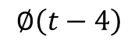
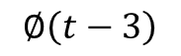
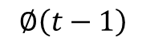
Multi Resolution Analysis(CO5)
f₁(t)
f₂(t)
1
$$∅\left(t\right)$$
$$∅\left(t−1\right)$$
$$∅\left(t−2\right)$$
$$∅\left(t−3\right)$$
$$∅\left(t−4\right)$$
t
$$0$$
1
2
3
4
5
Signals which are not in V₀

Slide 40
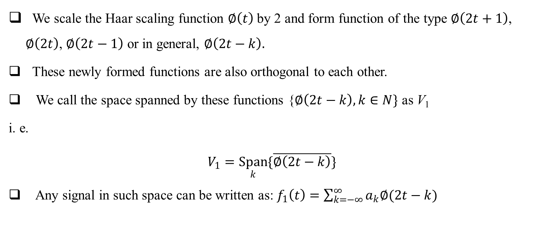
Multi Resolution Analysis(CO5)
We scale the Haar scaling function $∅\left(t\right)$by 2 and form function of the type $∅\left(2t+1\right)$, $∅\left(2t\right)$, $∅\left(2t−1\right)$ or in general, $∅\left(2t−k\right).$
These newly formed functions are also orthogonal to each other.
We call the space spanned by these functions {$∅\left(2t−k\right),k∈N\}$ as V₁
i. e.
$$V_{1}=\underset{k}{Span}{\{\overline{∅\left(2t−k\right)}\}}$$
Any signal in such space can be written as: $f_{1}\left(t\right)=\sum_{k=−∞}^{∞}{a_{k}∅(2t−k)}$

Slide 41
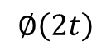
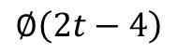
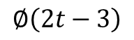
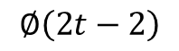
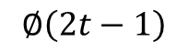
Multi Resolution Analysis(CO5)
1
$$∅\left(2t\right)$$
$$∅\left(2t−1\right)$$
$$∅\left(2t−2\right)$$
$$∅\left(2t−3\right)$$
$$∅\left(2t−4\right)$$
1.5
t
$$0$$
0.5
1
2
2.5
Haar scaling functions which forms the basis for V₁

Slide 42
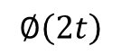
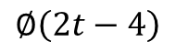
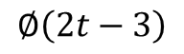
Multi Resolution Analysis(CO5)
f(t)
1
$$∅\left(2t\right)$$
$$∅\left(2t−1\right)$$
$$∅\left(2t−2\right)$$
$$∅\left(2t−3\right)$$
$$∅\left(2t−4\right)$$
1.5
t
$$0$$
0.5
1
2
2.5
A signal f(t) which is element of space V₁

Slide 43
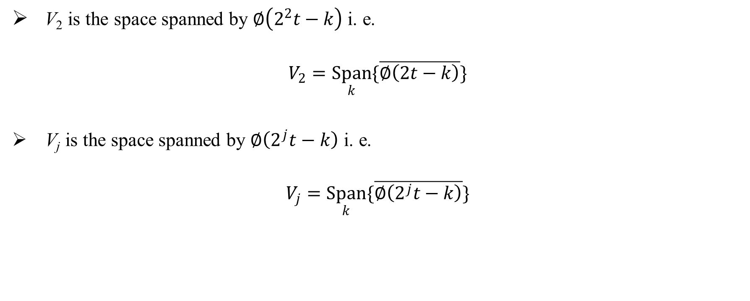
Multi Resolution Analysis(CO5)
V₂ is the space spanned by $∅\left(2^{2}t−k\right)$i. e.
$$V_{2}=\underset{k}{Span}{\{\overline{∅\left(2t−k\right)}\}}$$
V_{j} is the space spanned by $∅\left(2^{j}t−k\right) \text{i}\text{. }\text{e}\text{.}$
$$V_{j}=\underset{k}{Span}{\{\overline{∅\left(2^{j}t−k\right)}\}}$$

Slide 44
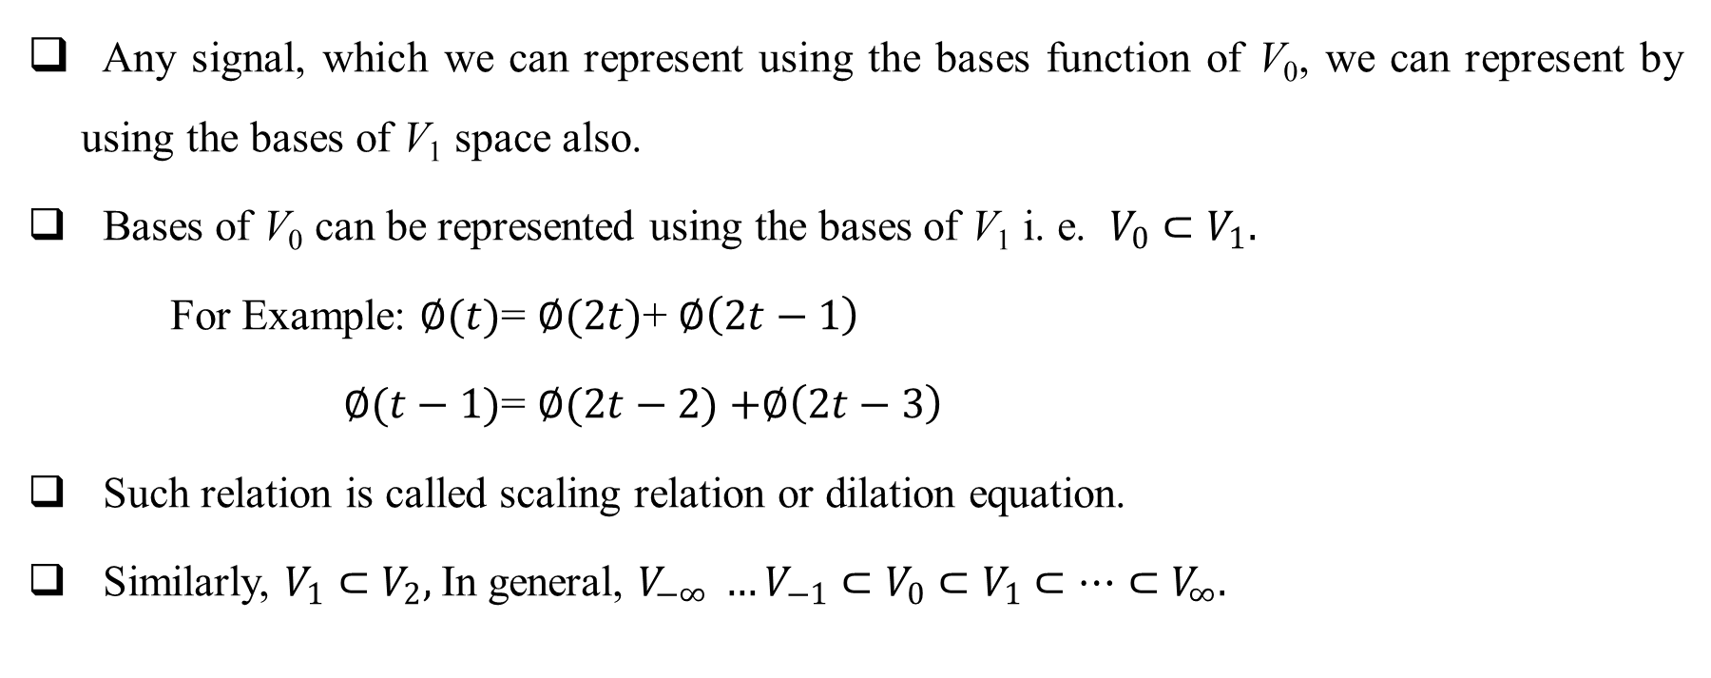
Multi Resolution Analysis(CO5)
Any signal, which we can represent using the bases function of V₀, we can represent by using the bases of V₁ space also.
Bases of V₀ can be represented using the bases of V₁ i. e. $V_{0}⊂V_{1}.$
For Example: $∅(t)$= $∅(2t)$+ $∅\left(2t−1\right)$
$∅(t−1)$= $∅(2t−2)$ $+∅\left(2t−3\right)$
Such relation is called scaling relation or dilation equation.
Similarly, $V_{1}⊂V_{2},$In general, $V_{−∞} {…V}_{−1}⊂V_{0}$ $⊂V_{1}$ $⊂…{⊂V}_{∞}.$

Slide 45
Multi Resolution Analysis(CO5)
V₀
V₂
V₁
${V_{−∞}…⊂ V_{−1}⊂V}_{0}⊂$ $V_{1}$ ${⊂V}_{2}⊂$… $V_{∞}$

Slide 46
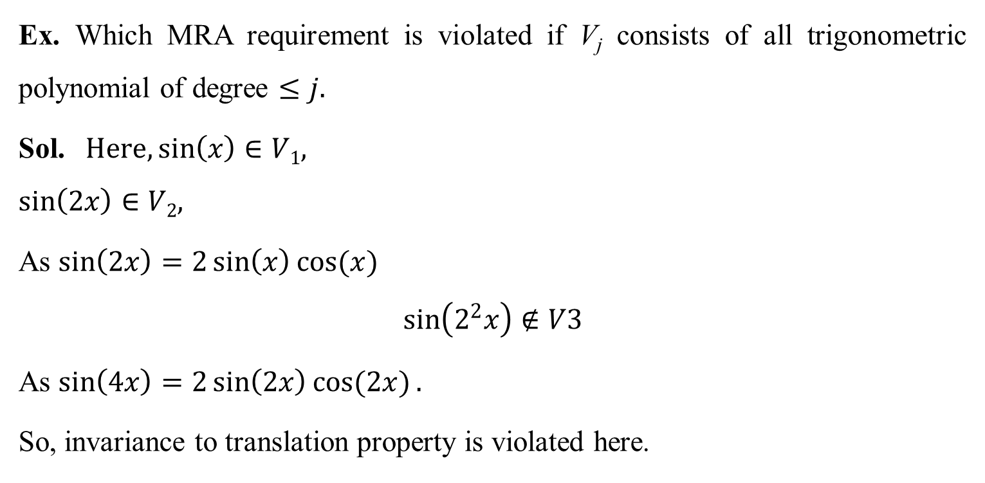
Multi Resolution Analysis(CO5)
Ex. Which MRA requirement is violated if V_{j} consists of all trigonometric polynomial of degree $≤j.$
Sol. $Here, \sin\left(x\right)∈V1,$
$$\sin\left(2x\right)∈V2,$$
As $\sin\left(2x\right)=2\sin\left(x\right)cos(x)$
$$\sin\left(2^{2}x\right)∉V3$$
As $\sin\left(4x\right)=2\sin\left(2x\right)cos(2x).$
So, invariance to translation property is violated here.

Slide 47
Daily Quiz(CO5)
Write down the axioms of multiresolution analysis.
Write down the dilation equation.

Slide 48
Prerequisite and Recap(CO5)
In previous lectures we have discussed-
Concept of nested space
Multiresolution analysis

Slide 49
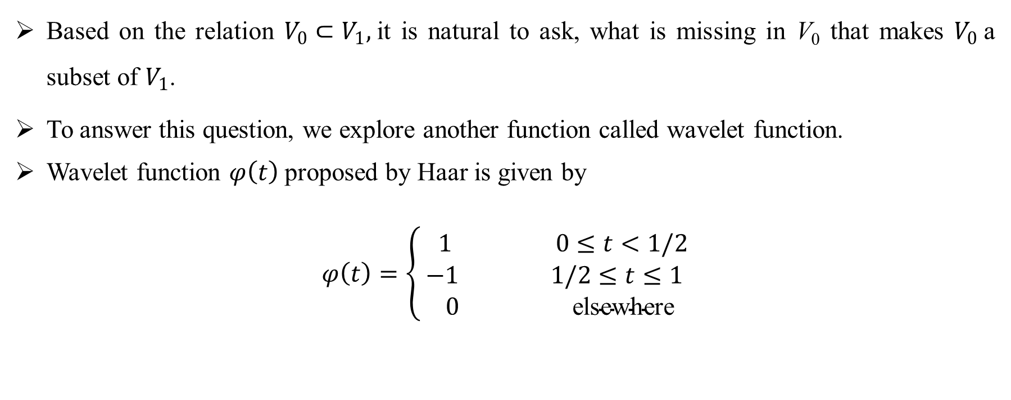
Wavelet Function(CO5)
Based on the relation $V_{0}⊂V_{1},$it is natural to ask, what is missing in V₀ that makes $V_{0}$a subset of $V_{1}$.
To answer this question, we explore another function called wavelet function.
Wavelet function $φ\left(t\right)$proposed by Haar is given by
$$φ\left(t\right)=\left\{\begin{aligned} 1 0≤t<1/2 \\ −1 1/2≤t≤1 \\ 0 \text{elsewhere}\end{aligned}\right.$$

Slide 50
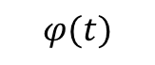
Wavelet Function(CO5)
$$φ(t)$$
1
t
1/2
1
-1

Slide 51
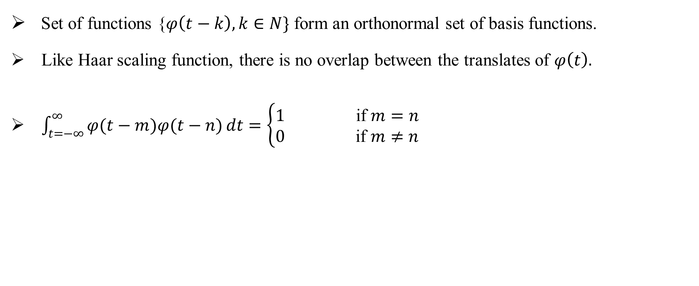
Wavelet Function(CO5)
Set of functions {$φ\left(t−k\right), k∈N\}$ form an orthonormal set of basis functions.
Like Haar scaling function, there is no overlap between the translates of $φ\left(t\right).$
$\int_{t=−∞}^{∞}{φ(t−m)φ(t−n)}dt=\left\{\begin{aligned}1 \text{if} m=n \\ 0 \text{if} m≠n\end{aligned}\right.$

Slide 52
Wavelet Function(CO5)
Haar Wavelet Function

Slide 53
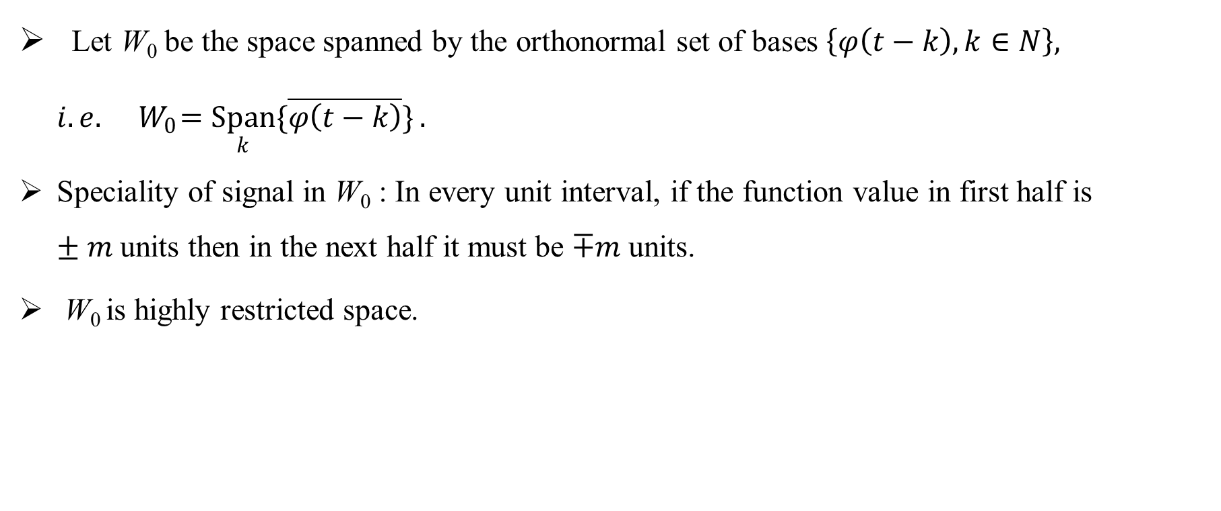
Wavelet Function(CO5)
Let W₀ be the space spanned by the orthonormal set of bases $\left\{φ\left(t−k\right),k∈N\right\}, i. e. { W}_{0}=\underset{k}{Span}{\{\overline{φ\left(t−k\right)}\}}.$
Speciality of signal in W₀ : In every unit interval, if the function value in first half is $±m$units then in the next half it must be $∓m$units.
W₀ is highly restricted space.

Slide 54
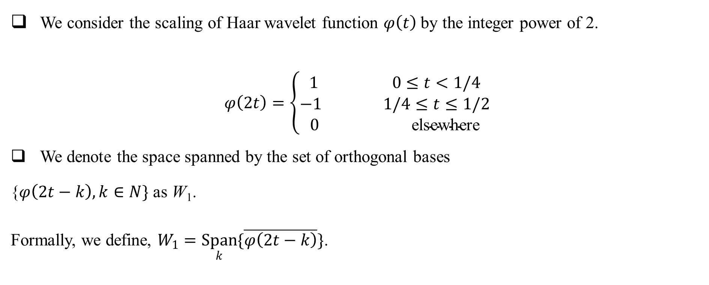
Wavelet Function(CO5)
We consider the scaling of Haar wavelet function $φ\left(t\right)$by the integer power of 2.
$$φ\left(2t\right)=\left\{\begin{aligned}1 0≤t<1/4 \\ −1 1/4≤t≤1/2 \\ 0 \text{elsewhere}\end{aligned}\right.$$
We denote the space spanned by the set of orthogonal bases
{$φ\left(2t−k\right),k∈N\}$ as W₁.
Formally, we define, $W_{1}=\underset{k}{Span}{\{\overline{φ\left(2t−k\right)}\}}$.

Slide 55
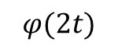
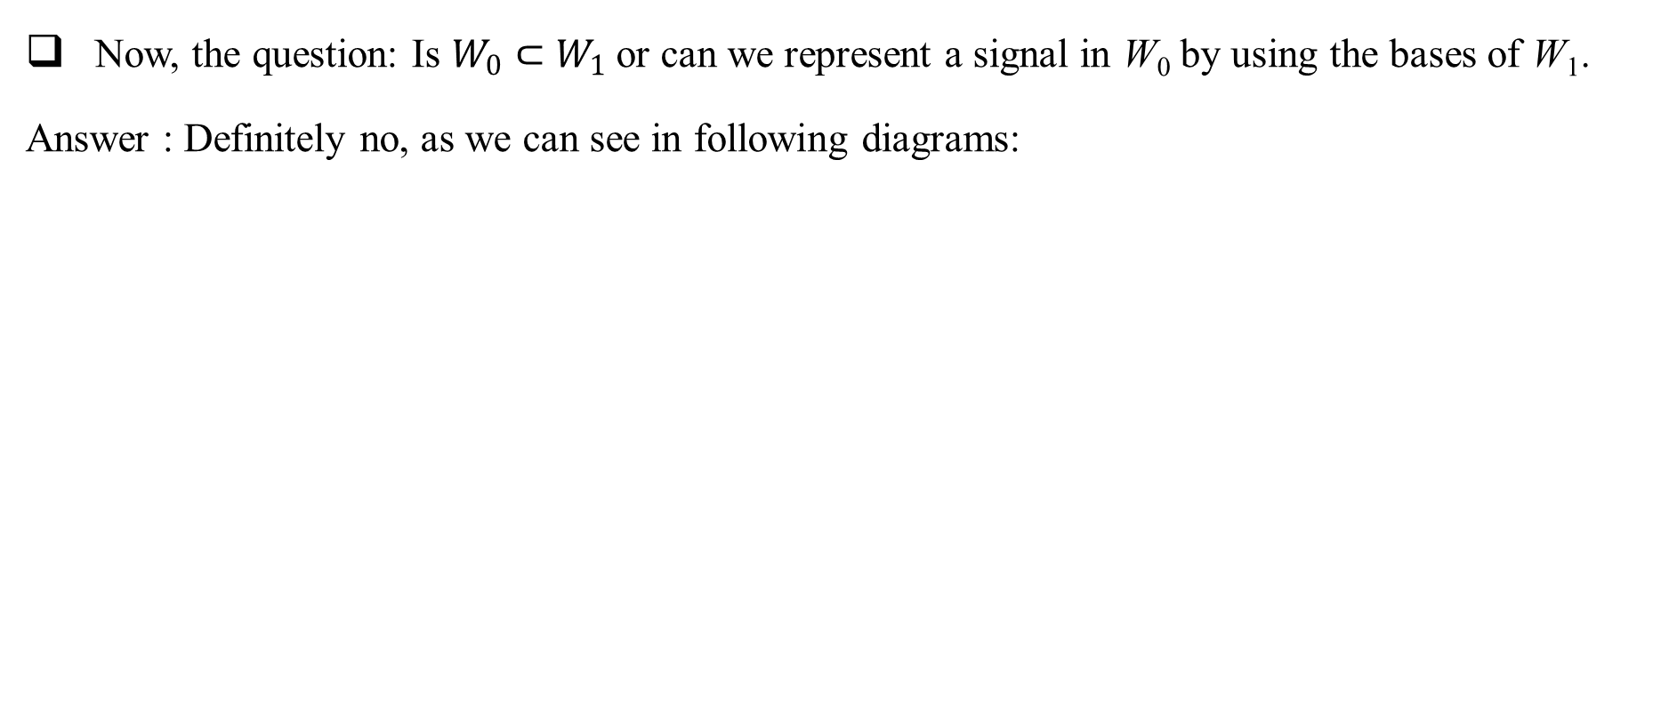
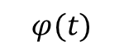
Wavelet Function(CO5)
Now, the question: Is $W_{0}⊂W_{1}$or can we represent a signal in W₀ by using the bases of W₁.
Answer : Definitely no, as we can see in following diagrams:
$$φ(t)$$
$$φ(2t)$$

Slide 56
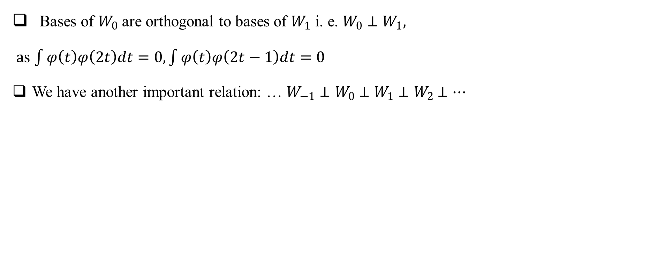
Wavelet Function(CO5)
Bases of $W_{0}$are orthogonal to bases of $W_{1}$ i. e. $W_{0}⊥W_{1},$
$a$s $\int{φ\left(t\right)φ\left(2t\right)dt}=0,\int{φ\left(t\right)φ\left(2t−1\right)dt}=0$
We have another important relation: … $W_{−1}⊥W_{0}$ $⊥W_{1}$ $⊥W_{2}$ $⊥…$

Slide 57
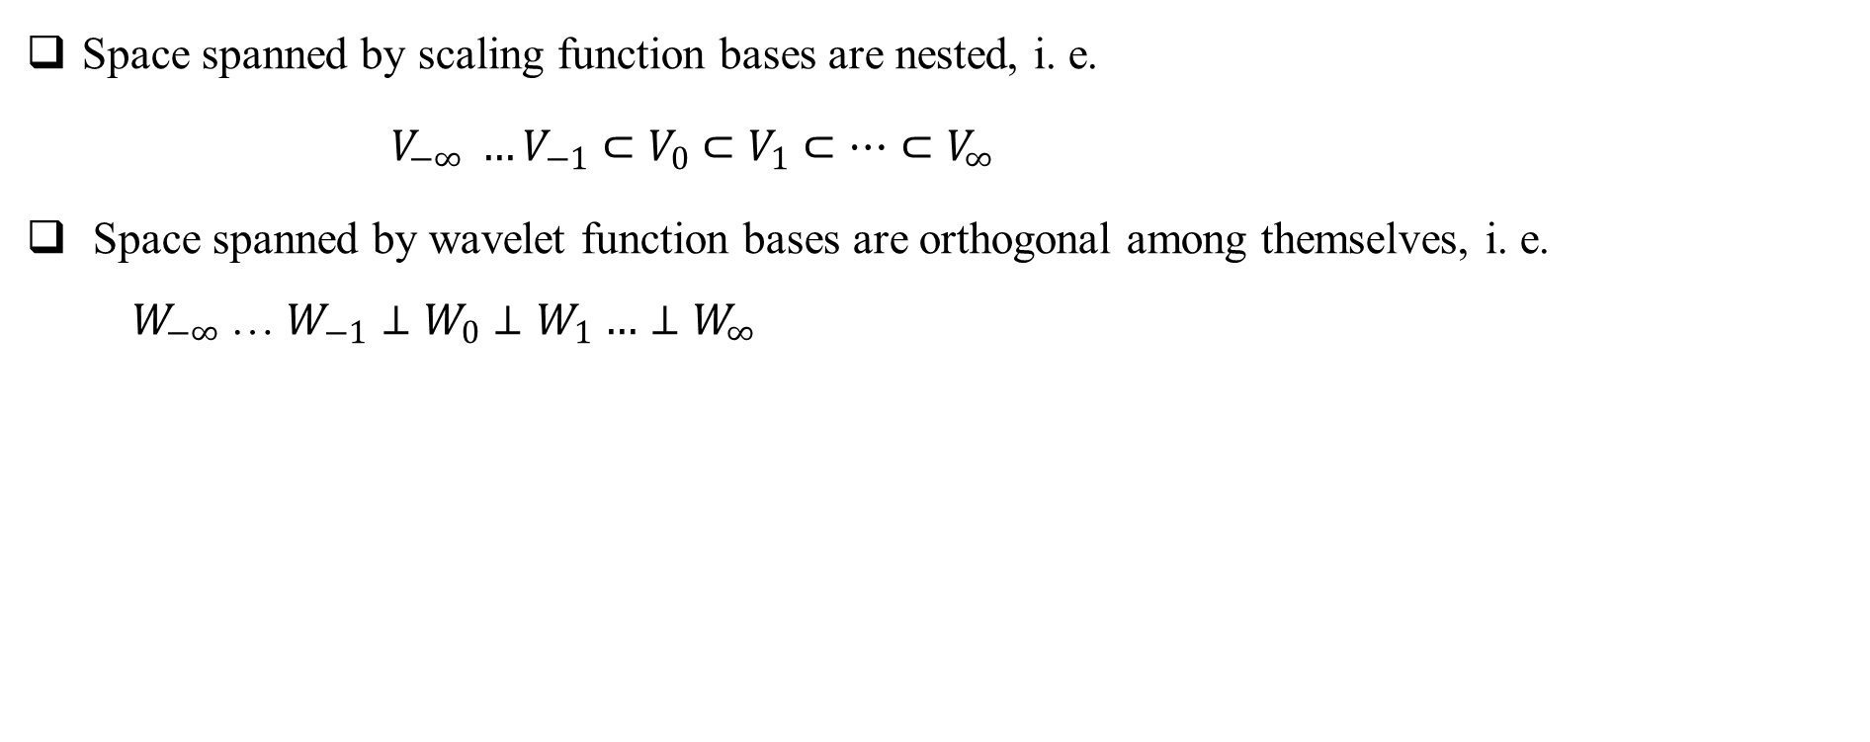
Wavelet Function(CO5)
Space spanned by scaling function bases are nested, i. e.
$V_{−∞} {…V}_{−1}⊂V_{0}$ $⊂V_{1}$ $⊂…{⊂V}_{∞}$
Space spanned by wavelet function bases are orthogonal among themselves, i. e. ${ W}_{−∞}$… $W_{−1}⊥W_{0}$ $⊥W_{1}$ $…{⊥W}_{∞}$

Slide 58
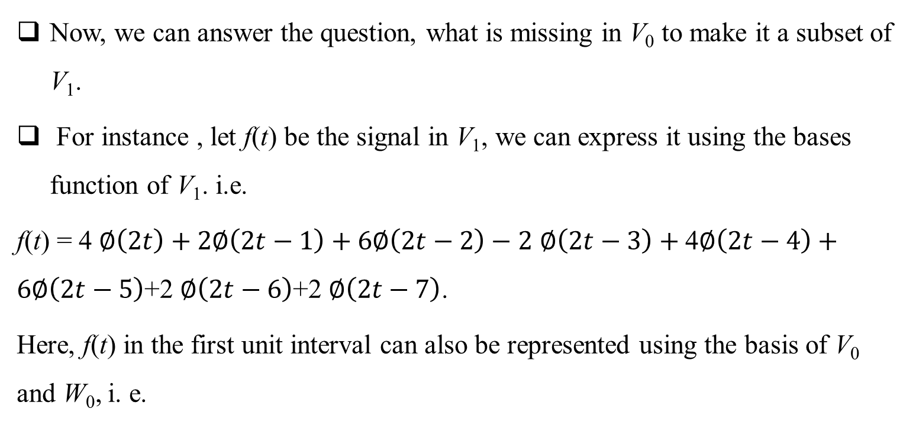
Wavelet Function(CO5)
Now, we can answer the question, what is missing in V₀ to make it a subset of V₁.
For instance , let f(t) be the signal in V₁, we can express it using the bases function of V₁. i.e.
f(t) = 4 $∅\left(2t\right)+2∅\left(2t−1\right)+6∅\left(2t−2\right)−2$ $∅\left(2t−3\right)+$ 4$∅\left(2t−4\right)+6∅\left(2t−5\right)$+2 $∅\left(2t−6\right)$+2 $∅\left(2t−7\right)$.
Here, f(t) in the first unit interval can also be represented using the basis of V₀ and W₀, i. e.

Slide 59
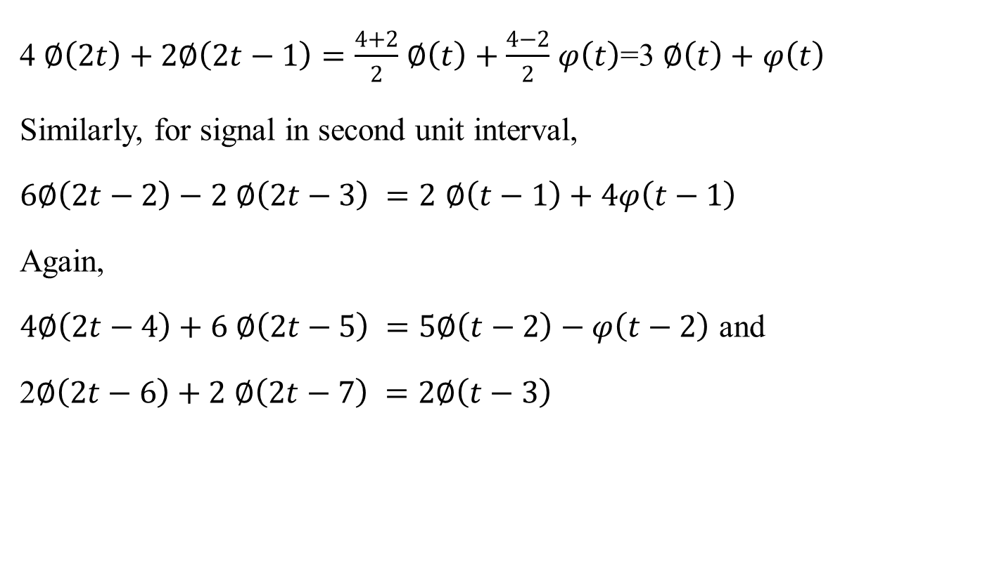
Wavelet Function(CO5)
4 $∅\left(2t\right)+2∅\left(2t−1\right)=\frac{4+2}{2}$ $∅\left(t\right)+$ $\frac{4−2}{2}$ $φ\left(t\right)$=3 $∅\left(t\right)+$ $φ\left(t\right)$
Similarly, for signal in second unit interval,
$6∅\left(2t−2\right)−2$ $∅\left(2t−3\right) =2$ $∅\left(t−1\right)+$ $4φ\left(t−1\right)$
Again,
$4∅\left(2t−4\right)+6$ $∅\left(2t−5\right) =5∅\left(t−2\right)−φ\left(t−2\right)$ and
2$∅\left(2t−6\right)+2$ $∅\left(2t−7\right) =2∅\left(t−3\right)$

Slide 60
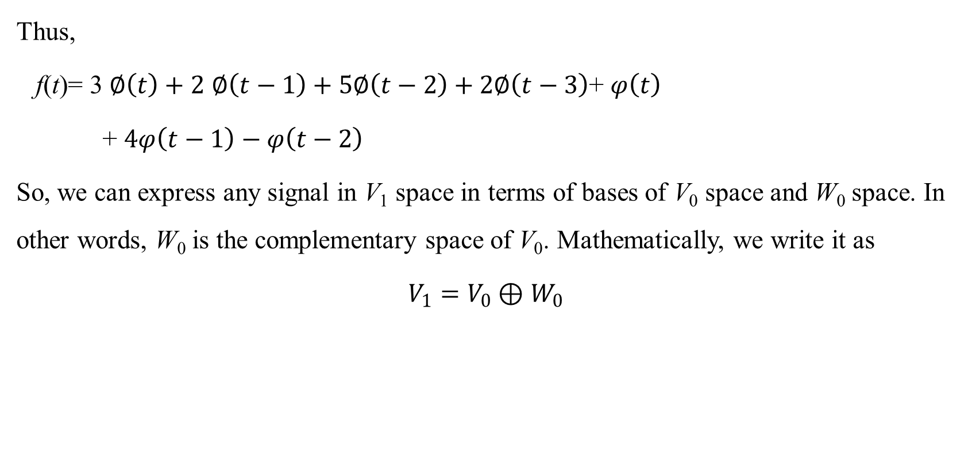
Wavelet Function(CO5)
Thus,
f(t)= 3 $∅\left(t\right)+2$ $∅\left(t−1\right)+5∅\left(t−2\right)+2∅\left(t−3\right)$+ $φ\left(t\right)$
+ $4φ\left(t−1\right)−φ\left(t−2\right)$
So, we can express any signal in V₁ space in terms of bases of V₀ space and W₀ space. In other words, W₀ is the complementary space of V₀. Mathematically, we write it as
$V_{1}=V_{0}⊕$ $W_{0}$

Slide 61
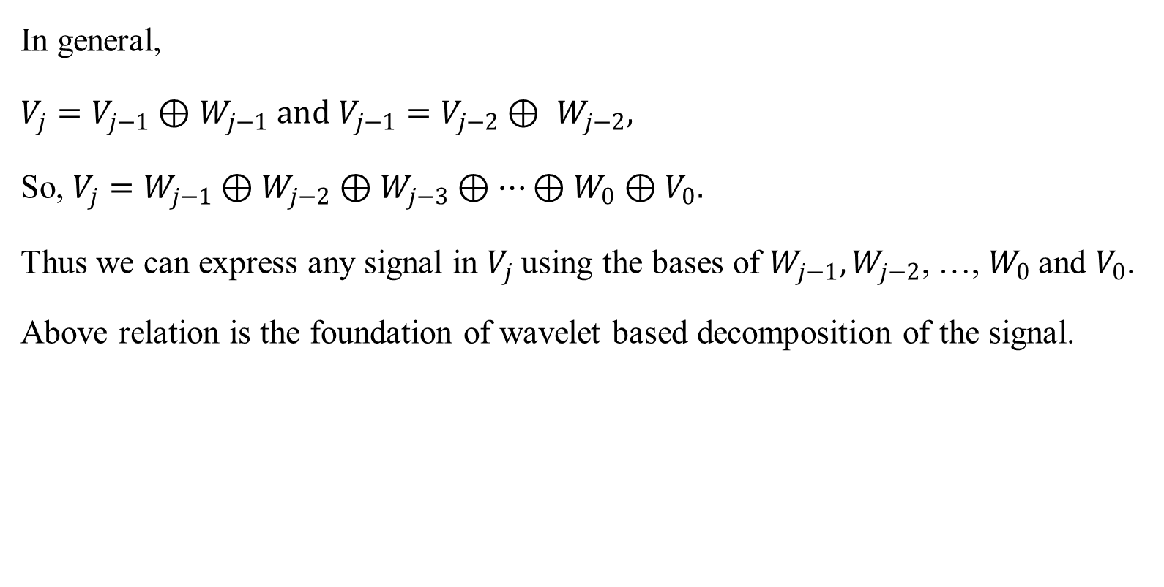
Wavelet Function(CO5)
In general,
$V_{j}=V_{j−1}⊕$ $W_{j−1} and V_{j−1}=V_{j−2}⊕ W_{j−2},$
So, $V_{j}=W_{j−1}⊕W_{j−2}⊕W_{j−3}⊕…{⊕W}_{0}$ $⊕V_{0}.$
Thus we can express any signal in $V_{j}$using the bases of $W_{j−1},W_{j−2}$, …, $W_{0}$and $V_{0}$.
Above relation is the foundation of wavelet based decomposition of the signal.

Slide 62
Wavelet Function(CO5)
Schematically,

Slide 63
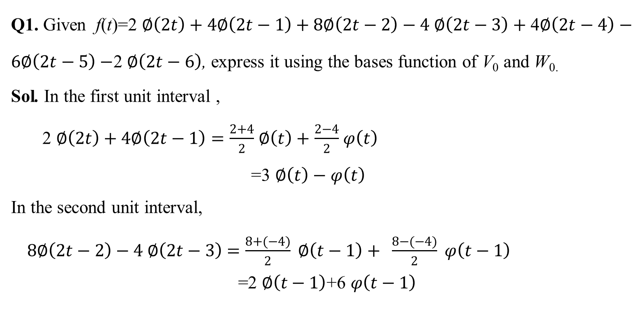
Wavelet Function(CO5)
Q1. Given f(t)=2 $∅\left(2t\right)+4∅\left(2t−1\right)+8∅\left(2t−2\right)−4 ∅\left(2t−3\right)+$ 4$∅\left(2t−4\right)−6∅\left(2t−5\right)−$2 $∅\left(2t−6\right)$, express it using the bases function of V₀ and W_{0.}
Sol. In the first unit interval ,
2 $∅\left(2t\right)+4∅\left(2t−1\right)=\frac{2+4}{2}$ $∅\left(t\right)+$ $\frac{2−4}{2}$ $φ\left(t\right)$
=3 $∅\left(t\right)−$ $φ\left(t\right)$
In the second unit interval,
$8∅\left(2t−2\right)−4 ∅\left(2t−3\right)$ $=\frac{8+(−4)}{2} ∅\left(t−1\right)+ \frac{8−(−4)}{2} φ\left(t−1\right)$
$$\text{=}\text{2} ∅\left(t−1\right)\text{+6} φ\left(t−1\right)$$

Slide 64

Wavelet Function(CO5)
Similarly, in the third unit interval,
4$∅\left(2t−4\right)−6∅\left(2t−5\right) =\frac{4−6}{2}$ $∅\left(t−2\right)+$ $\frac{4+6}{2}$ $φ\left(t−2\right)$
= $−∅\left(t−2\right)+5$ $φ\left(t−2\right)$
In the last unit interval,
$−$2 $∅\left(2t−6\right) +0 ∅\left(2t−7\right)=\frac{−2+0}{2}$ $∅\left(t−3\right)+$ $\frac{−2−0}{2}$ $φ\left(t−3\right)$
= $−∅\left(t−3\right)−$ $φ\left(t−3\right)$
Thus,
f(t)= 3 $∅\left(t\right)−$ $φ\left(t\right) +\text{2} ∅\left(t−1\right)\text{+6} φ\left(t−1\right)$ $−∅\left(t−2\right)+5$ $φ\left(t−2\right)$ $−∅\left(t−3\right)−$ $φ\left(t−3\right)$.

Slide 65

Wavelet Function(CO5)
Q2. Given f(t)=2 $∅\left(4t\right)+4∅\left(4t−1\right)+8∅\left(4t−2\right)−4 ∅\left(4t−3\right)$, express it using the bases function of V₀ , W₀ and W₁.
Sol. Here, 2 $∅\left(4t\right)+4∅\left(4t−1\right)$= $\frac{2+4}{2}$ $∅\left(2t\right)+$ $\frac{2−4}{2}$ $φ\left(2t\right)$
=3 $∅\left(2t\right)−φ\left(2t\right)$
and
8$∅\left(4t−2\right)−4 ∅\left(4t−3\right)$=$\frac{8−4}{2}$ $∅\left(2t\right)+$ $\frac{8+4}{2}$ $φ\left(2t\right)$
=2 $∅\left(2t−1\right)+6φ\left(2t−1\right)$

Slide 66

Wavelet Function(CO5)
So, f(t)= 3 $∅\left(2t\right)\text{+ 2} ∅\left(2t−1\right)−φ\left(2t\right)+6φ\left(2t−1\right)$
= $\frac{3+2}{2}$ $∅\left(t\right)+$ $\frac{3−2}{2}$ $φ\left(t\right)$ $−φ\left(2t\right)+6φ\left(2t−1\right)$
=$\frac{5}{2}$ $∅\left(t\right)−$ $\frac{1}{2}$ $φ\left(t\right)$ $−φ\left(2t\right)+6φ\left(2t−1\right)$

Slide 67


Wavelet Function(CO5)
Represent the function f(t)=3 $∅\left(t\right)+\text{4} ∅\left(t−1\right)+$ 2 $∅\left(t−2\right)+$ 5 $∅\left(t−3\right)$ using the bases of V₁ space.
Represent the function f(t)=3$∅\left(2t\right)+\text{4} ∅\left(2t−1\right)$+2$∅\left(2t−2\right)+$5 $∅\left(2t−3\right)$ using the bases of V₀ and W₀ space.
Represent the function f(t)=3$∅\left(4t\right)+\text{4} ∅\left(4t−1\right)$+2$∅\left(4t−2\right)+$5 $∅\left(4t−3\right)$ using the bases of V₀, W₀ and W₁ space.

Slide 68

Wavelet Function(CO5)
$$\int{∅\left(t\right)φ\left(t\right)dt}=\int_{t=0}^{0.5}{1.1}dt+\int_{t=0.5}^{1}{1.(−1)}dt=0$$

Slide 69
Wavelet Function(CO5)
ORTHOGONALITY OF $∅\left(t\right)$ AND $φ\left(t\right):$

Slide 70

Wavelet Function(CO5)
NORMALIZATION OF HAAR BASES AT DIFFERENT SCALES:
If we talk about the bases of V₀, i.e. $∅\left(t−k\right) , they are orthogonal.$
M$oreover, \int{∅\left(t−k\right)∅\left(t−k\right)dt}=1, means they are orthonormal also.$
But for the bases of V₁, we have $\int{∅\left(2t−k\right)∅\left(2t−k\right)dt}=1/2$, to make them orthonormal, we multiply each of $∅\left(2t−k\right)$ with $√2.$
Then, we have
$$\int{√2∅\left(2t−k\right)√2∅\left(2t−k\right)dt}=1$$

Slide 71

Wavelet Function(CO5)
We redefine V₁ as
$$V_{1}=\underset{k}{Span}{\{\overline{2^{1/2}∅\left(2t−k\right)}\}}.$$
Similarly, V₂ is redefined as
$V_{2}=\underset{k}{Span}{\{\overline{2^{2/2}∅\left(2^{2}t−k\right)}\}}.$
In general,
$V_{j}=\underset{k}{Span}{\{\overline{2^{j/2}∅\left(2^{j}t−k\right)}\}}$.
Similarly, bases of W_{j} are normalized.

Slide 72

Wavelet Function(CO5)
STANDARDIZING THE NOTATIONS:
We write ${ 2}^{j/2}∅\left(2^{j}t−k\right) a$s $∅_{j,k}\left(t\right)$
Basis of V₀: {$∅_{0,−1}\left(t\right),∅_{0,0}\left(t\right),∅_{0,1}\left(t\right),…,∅_{0,k}\left(t\right),…\}$
Basis of V_{j}: {$∅_{j,−1}\left(t\right)$, $∅_{j,0}\left(t\right)$, $∅_{j,1}\left(t\right)$,…, $∅_{j,k}\left(t\right)$,…}
Basis of W_{j}:{$φ_{j,−1}\left(t\right)$, $φ_{j,0}\left(t\right)$, $φ_{j,1}\left(t\right)$,…, $φ_{j,k}\left(t\right)$,…}
Where, $φ_{j,k}\left(t\right)$= $2^{j/2}φ\left(2^{j}t−k\right)$.

Slide 73

Wavelet Function(CO5)
For instance, If we take
j=0, k=0; $∅_{0,0}\left(t\right)=∅\left(t\right)$
j=0, k=1; $∅_{0,1}\left(t\right)=∅\left(t−1\right)$
j=1, k=0; $∅_{1,0}\left(t\right)=2^{1/2}∅\left(2t\right)$
j=1, k=1; $∅_{1,1}\left(t\right)=2^{1/2}∅\left(2t−1\right)$

Slide 74

Wavelet Function(CO5)
REFINEMENT RELATION W. R. T. NORMALIZED BASES:
With respect to un-normalized bases, we have
$∅\left(t\right)=$ $∅\left(2t\right)$+ $∅\left(2t−1\right)$
Similarly, $φ\left(t\right)=∅$(2t) $− ∅$(2t $−$1)
With respect to normalized bases,
$∅\left(t\right)=\frac{1}{√2}√2∅\left(2t\right)$+ $\frac{1}{√2}√2$ $∅\left(2t−1\right)=$ $\frac{1}{√2}∅_{1,0}\left(t\right)+\frac{1}{√2}∅_{1,1}\left(t\right)$
$φ\left(t\right)=$ $\frac{1}{√2}\sqrt{2}∅\left(2t\right)−$ $\frac{1}{√2}√2$ $∅\left(2t−1\right)=$ $\frac{1}{√2}∅_{1,0}\left(t\right)−\frac{1}{√2}∅_{1,1}\left(t\right)$

Slide 75

Wavelet Function(CO5)
Generally we write these relations as:
$∅\left(t\right)=\sum_{k}{h(k)}∅_{1,k}\left(t\right)=\sum_{k}{h(k)}$ .$\sqrt{2}∅\left(2t−k\right)$
$φ\left(t\right)=$ $\sum_{k}{g(k)}∅_{1,k}\left(t\right)=\sum_{k}{g(k)}$ .$\sqrt{2}∅\left(2t−k\right)$
Specifically, for Haar
$∅\left(t\right)=\sum_{k=0}^{1}{h(k)}∅_{1,k}\left(t\right)=\sum_{k=0}^{1}{h(k)}$.$\sqrt{2}∅\left(2t−k\right)$
$φ\left(t\right)=\sum_{k=0}^{1}{g(k)}∅_{1,k}\left(t\right)=\sum_{k=0}^{1}{g(k)}$.$\sqrt{2}∅\left(2t−k\right)$

Slide 76

Wavelet Function(CO5)
Where, $h\left(0\right)=\frac{1}{√2}, h\left(1\right)=\frac{1}{√2},$ $g\left(0\right)=\frac{1}{√2}, g\left(1\right)=−\frac{1}{\sqrt{2}}.$
$\left\{h\left(k\right),k∈N\right\} and \left\{g\left(k\right),k∈N\right\}$are known as low pass scaling filter and high pass wavelet filter coefficients.

Slide 77
Prerequisite and Recap(CO5)
In previous lectures we have discussed-
Orthogonality of Haar scaling function and Haar wavelet function .
Refinement relation w.r.t. normalized bases.

Slide 78
Daily Quiz(CO5)
Describe the normalization process for the bases of V_{j} space.
2. How do we find the filter coefficients for Haar wavelet.

Slide 79

Weekly Assignment(CO5)
Define and plot Haar scaling function.
Prove that translates of Haar scaling function are orthonormal to each other.
Write down the dilation equation.
Represent the function f(t)=4 $∅\left(t\right)−5 ∅\left(t−1\right)+$ 3 $∅\left(t−2\right)+$ 5 $∅\left(t−3\right)$
using the bases of V₁ space.
Represent the function f(t)=3$∅\left(2t\right)+\text{4} ∅\left(2t−1\right)$+2$∅\left(2t−2\right)+$5 $∅\left(2t−3\right)$
using the bases of V₀ and W₀ space.
6. Represent the function f(t)=3$∅\left(4t\right)+\text{4} ∅\left(4t−1\right)$+2$∅\left(4t−2\right)+$5 $∅\left(4t−3\right)$ using the bases of V₀, W₀ and W₁ space.
7. Which MRA requirement is violated if V_{j} consists of all trigonometric polynomial of degree $≤j.$

Slide 80

Triangle Scaling Function(CO5)
Triangle Scaling Function:
This function is defined in [0, 2]. So, length of support is 2. It is defined as
$$∅ \left(t\right)=\left\{\begin{aligned} t 0≤t≤1 \\ 2−t 1≤t≤2 \\ 0 \text{elsewhere}\end{aligned}\right.$$
It obeys a scaling relation, $∅ \left(t\right)$= $\frac{1}{2}∅ \left(2t\right)$ $+∅ \left(2t−1\right)$+ $\frac{1}{2} ∅ \left(2t−2\right)$.

Slide 81
Triangle Scaling Function(CO5)

Slide 82

Triangle Scaling Function(CO5)
Triangular scaling function and its translates are not orthogonal among themselves. Therefore it does not form an orthogonal wavelet system.
To find the coefficient g(k)s for expressing $φ\left(t\right)$ in terms of $∅ \left(2t\right)$ and its translates, we flip(reverse the sequence of coefficients) h(k) and change the sign of alternate coefficients.
Here {1/2, 1, 1/2} are the sequence in h(k). Then g(k) coefficients are either {-1/2, 1, -1/2} or {1/2, -1, 1/2}.

Slide 83
Triangle Scaling Function(CO5)

Slide 84

Triangle Scaling Function(CO5)
Q. Express the function f(t)=$2∅\left(t\right)+\text{4} ∅\left(t−1\right)$ in terms of $∅\left(2t\right)$ and its translates, where $∅\left(t\right)$is triangle scaling function.
Sol. We know, $∅\left(t\right)$= $\frac{1}{2}$ $∅\left(2t\right)+$ $∅\left(2t−1\right)+ \frac{1}{2}∅\left(2t−2\right)$
and $∅\left(t−1\right)$= $\frac{1}{2}$ $∅\left(2t−2\right)+$ $∅\left(2t−3\right)+ \frac{1}{2}∅\left(2t−4\right)$
So, $2∅\left(t\right)+\text{4} ∅\left(t−1\right)$= $∅\left(2t\right)+$2 $∅\left(2t−1\right)+3 ∅\left(2t−2\right)$+ 4$∅\left(2t−3\right)+2∅\left(2t−4\right)$.

Slide 85
Triangle Scaling Function(CO5)
In previous lectures we have discussed-
Triangle Scaling Function

Slide 86

Daily Quiz(CO5)
Define and plot Triangle scaling function.
Express the function f(t)=$∅\left(t\right)+\text{3} ∅\left(t−1\right)$ in terms of $∅\left(2t\right)$ and its translates, where $∅\left(t\right)$is triangle scaling function.

Slide 87

Daubechies Wavelets(CO5)
Daubechies Wavelets: We will explore specifically here Daub-4 type wavelet system.
There is no explicit function for this wavelet system, so we can’t draw it directly.
We have coefficient of refinement relation means h_{k}s, which connects $∅ \left(t\right)$and translates of $∅ \left(2t\right)$.

Slide 88

Daubechies Wavelets(CO5)
To construct compactly supported wavelet
$∅ \left(x\right)=\sqrt{2}\sum_{k=−∞}^{∞}{h_{k}}∅ \left(2x−k\right)$ (dilation equation)
$φ \left(x\right)=\sqrt{2}\sum_{k=−∞}^{∞}{g_{k}}∅ \left(2x−k\right)$ (Wavelet equation)
Where, $g_{k}′$s and $h_{k}′$s are non zero.
Now, compactly supported wavelet whose order is defined by D (order of wavelets)
$∅ \left(x\right)=\sqrt{2}\sum_{k=0}^{D−1}{h_{k}}∅ \left(2x−k\right)$ (dilation equation)
$φ \left(x\right)=\sqrt{2}\sum_{k=0}^{D−1}{g_{k}}∅ \left(2x−k\right)$ (Wavelet equation)

Slide 89
Daubechies Wavelets(CO5)
To Evaluate scaling function and wavelet function there are 3 methods in literature:
Cascade Method
Spectral Method
Recursion Method

Slide 90

Daubechies Wavelets(CO5)
Coefficients h_{k}’s for normalized Daub-4 are:
$$h\left(0\right)=\frac{1}{4\sqrt{2}}(1+√3)$$
$$h\left(1\right)=\frac{1}{4\sqrt{2}}(3+√3)$$
$$h\left(2\right)=\frac{1}{4\sqrt{2}}(1−√3)$$
$h\left(0\right)=\frac{1}{4\sqrt{2}}(3−√3)$

Slide 91

Daubechies Wavelets(CO5)
Daubechies Wavelets(CO5)
Now,
$∅ \left(t\right)=h\left(0\right)\sqrt{2}∅ \left(2t\right)+h\left(1\right)\sqrt{2}∅ \left(2t−1\right)+$ $h\left(2\right)\sqrt{2}∅ \left(2t−2\right)$
$+$ $h\left(3\right)\sqrt{2}∅ \left(2t−3\right)$
Here, $∅ \left(t\right)$ is expressed in terms of $∅ \left(2t\right)$ and its translates.

Slide 92

Daubechies Wavelets(CO5)
Daub-4 Type Wavelets:

Slide 93
Daubechies Wavelets(CO5)
As we can see in the last figure, Daubechies wavelets are smooth but doesn’t have a compact support.
Haar wavelets are the only wavelets which are orthogonal, with compact support and smooth in nature.

Slide 94

Shanon Wavelets(CO5)
Scaling function and wavelet functions for Shanon wavelets are defined as:
$∅\left(x\right)={f_{b}}^{−5}\sin\left(f_{b}πx\right)$ and $φ\left(x\right)=∅\left(x\right)cos\left(1.5πx\right)$
Where, $f_{b}$is bandwidth parameter.

Slide 95
Prerequisite and Recap(CO5)
In previous lectures we have discussed-
Daubechies Wavelets
Shanon Wavelets

Slide 96
Orthogonal Wavelets(CO5)
Orthogonal Basis: In which each basis function is orthogonal to every other basis function.
Orthogonal Multiresolution Basis: In which, scaling functions are orthogonal to one another, wavelets are orthogonal to each other and each of the wavelets is orthogonal to every coarser scaling function.
Wavelets that satisfy these conditions are called orthogonal wavelets.

Slide 97
Signal Decomposition(CO5)
We never have to deal most of the applications directly with the scaling functions or associated wavelets. We need only h(n) and g(n) in refinement relation and the discretized signal. In this context, h(n) and g(n) are viewed as filters and sequence of data as digital signal.

Slide 98

Signal Decomposition(CO5)
The relation responsible for signal decomposition :
$∅ \left(t\right)=\sum_{n=0}^{N−1}{h(n)}\sqrt{2}∅ \left(2t−n\right)=$ $\sum_{n=0}^{N−1}{h\left(n\right)}∅_{1,n}\left(t\right)$
Here, N is the number of coefficients in the refinement relation.
For Haar, N = 2, and the relation is:
$$∅ \left(t\right)=h\left(0\right)\sqrt{2}∅ \left(2t\right)+h\left(1\right)\sqrt{2}∅ \left(2t−1\right)$$
=$h\left(0\right)∅_{1,0} \left(t\right)+h\left(1\right)∅_{1,1} \left(t\right)$.
For Haar, $h\left(0\right)=\frac{1}{√2} and h\left(1\right)=\frac{1}{√2}$

Slide 99

Signal Decomposition(CO5)
We aim at relating j^{th} level $∅$ with the next higher level j+1.
So, we write,
$$∅ \left(2^{j}t−k\right)=\sum_{n=0}^{N−1}{h(n)}\sqrt{2}∅ \left(2(2^{j}t−k)−n\right)=\sum_{n=0}^{N−1}{h(n)}\sqrt{2}∅ \left(2^{j+1}t−2k−n\right)$$
Let m = 2k + n,
$∅ \left(2^{j}t−k\right)$= $\sum_{m=2k}^{2k+N−1}{h(m−2k)}\sqrt{2}∅ \left(2^{j+1}t−m\right)$ …(1)
Similarly, $φ\left(2^{j}t−k\right)$= $\sum_{m=2k}^{2k+N−1}{g(m−2k)}\sqrt{2}∅ \left(2^{j+1}t−m\right)$

Slide 100

Signal Decomposition(CO5)
For Example, if we take j=0, k=3 and N=2(for Haar),
$$∅ \left(2^{0}t−3\right)=\sum_{m=6}^{7}{h(m−6)}\sqrt{2}∅ \left(2t−m\right)$$
$=h\left(0\right)\sqrt{2}∅ \left(2t−6\right)+h\left(1\right)\sqrt{2}∅ \left(2t−7\right)$
Since for Haar, $h\left(0\right)=\frac{1}{√2}$ and $h\left(1\right)=\frac{1}{√2},$
$∅ \left(t−3\right)=$ $∅ \left(2t−6\right)$+ $∅ \left(2t−7\right)$, which we have seen earlier.

Slide 101

Signal Decomposition(CO5)
If we denote V_{j} as $V_{j}=\underset{k}{Span}{\{\overline{2^{j/2}∅\left(2^{j}t−k\right)}\}}$
Then any function f(t) in $V_{j+1}$ implies $f\left(t\right)=\sum_{k}{s_{j+1}(k)2^{(j+1)/2}}$ $∅$ ($2^{j+1}t−k)$
$i. e. f(t)$ is expressed as linear combination of bases of $V_{j+1}$. At this scale wavelets are not coming into picture. Since $V_{j+1}=V_{j}⊕$ $W_{j}$, to represent same signal at next lower scale, we require the help of wavelets. So, we have
$f\left(t\right)=\sum_{k}{s_{j}(k)2^{j/2}}$ $∅$ ($2^{j}t−k)$+$\sum_{k}{d_{j}(k)2^{j/2}}$ $φ$ ($2^{j}t−k)$
Where, $s_{j}\left(k\right)=\int{f\left(t\right)2^{j/2}∅\text{(}2^{j}t−k)}dt$ …(2)

Slide 102

Signal Decomposition(CO5)
Which is simply a projection of f(t) onto the corresponding normalized base $2^{j/2}$ $φ$ ($2^{j}t−k)$
Subsituting equation 1 into equation 2 and interchanging summation and integral,
We have, $s_{j}\left(k\right)=\sum_{m=2k}^{2k+N−1}{h(m−2k)}\int{f\left(t\right)2^{(j+1)/2}∅\text{(}2^{j+1}t−m)}dt$
= $\sum_{m=2k}^{2k+N−1}{h(m−2k)}$ $s_{j+1}\left(m\right)$
The corresponding relationship for the wavelet coefficient is:
$d_{j}\left(k\right)$= $\sum_{m=2k}^{2k+N−1}{g(m−2k)}$ $s_{j+1}\left(m\right)$

Slide 103
Applications of Wavelets(CO5)
Wavelets are mathematical functions which are used as a basis for writing down other complex functions in an easy way. These cut up data into its frequency components and so that we can study each and every part with more preciseness as it is scaled for our convenience. We may also term wavelets as a tool to decompose signals and trend as a function of time. Wavelets are certainly used in place of the applications of Fourier Analysis as wavelets give more freedom to work on. Apart from pure mathematics areas, wavelets are highly useful tool in analyzing a time series. Wavelets are used for removing noise from a statistical data which is one of the most important job in data analysis. The applications of wavelets not only bars here, but they are also used in quantum physics, artificial intelligence and visual recognition.

Slide 104

Weekly Assignment(CO5)
Represent the function f(t)=$∅\left(2t\right)+\text{4} ∅\left(2t−1\right)+$2$∅\left(2t−2\right)+$5 $∅\left(2t−3\right)+$ 2$∅\left(2t−2\right)$ using the bases of V₀ and W₀ space.
Represent the function f(t)=$∅\left(4t\right)+\text{4} ∅\left(4t−1\right)+$2$∅\left(4t−2\right)$ using the bases of V₁, V₀ and W₀ space.
Describe the process of normalization of Haar bases at different scales.
Define and plot Triangle scaling function.
Express the function f(t)=$∅\left(t\right)+\text{3} ∅\left(t−1\right)$ in terms of $∅\left(2t\right)$ and its translates, where $∅\left(t\right)$is triangle scaling function.

Slide 105
Prerequisite and Recap(CO5)
In previous lectures we have discussed-
Orthogonal wavelets
Signal Decomposition
Application of Wavelets

Slide 106
Topic objective (CO5)
Number System
Understand the concept of various type of numbers & Its divisibility.

Slide 107
Number System (CO5)
Number System is divided into 4 parts:
Classification
Divisibility Test
Division and Remainder Rules
Sum Rules

Slide 108
Number System (CO5)
TRICKS TO REMEMBER FOR NUMBER SYSTEM:
1. Classification:
Types | Description
Natural Numbers | all counting numbers ( 1,2,3,4,5….∞)
Whole Numbers | natural number + zero( 0,1,2,3,4,5…∞)
Integers | All whole numbers including Negative number + Positive number (∞……-4,-3,-2,-1,0,1,2,3,4,5….∞)
Even & Odd Numbers | All whole number divisible by 2 is Even (0,2,4,6,8,10,12…..∞) and which does not divide by 2 are Odd (1,3,5,7,9,11,13,15,17,19….∞)
Prime Numbers | it can be positive or negative except 1, if the number is not divisible by any number except the number itself.(2,3,5,7,11,13,17,19,23,29,31,37,41,43,47,53,59,61….∞)
Composite Numbers | Natural numbers which are not prime.
Co-Prime | Two natural number a and b are said to be co-prime if their HCF is 1.

Slide 109
Number System (CO5)
2. Divisibility:
Numbers | if a Number
Divisible by 2 | End with 0,2,4,6,8 are divisible by 2
Divisible by 3 | Sum of its digits is divisible by 3
Divisible by 4 | Last two digit divisible by 4
Divisible by 5 | Ends with 0 or 5
Divisible by 6 | Divides by Both 2 & 3
Divisible by 8 | Last 3 digit divide by 8
Divisible by 10 | End with 0
Divisible by 11 | [Sum of its digit in odd places-Sum of its digits in even places]= 0 or multiple of 11
Divisible by 12 | [The number must be divisible by 3 and 4]

Slide 110
Number System (CO5)
Divisible by 13 | [Multiply last digit with 4 and add it to remaining number in given number, result must be divisible by 13]
Divisible by 14 | [The number must be divisible by 2 and 7. Because 2 and 7 are prime factors of14.]
Divisible by 15 | [The number should be divisible by 3 and 5. Because 3 and 5 are prime factors of15.]
Divisible by 16 | [The number formed by last four digits in given number must be divisible by 16.]
Divisible by 17 | [Multiply last digit with 5 and subtract it from remaining number in given number, result must be divisible by 17]
Divisible by 18 | [The number should be divisible by 2 and 9]
Divisible by 19 | [Multiply last digit with 2 and add it to remaining number in given number, result must be divisible by 19]
Divisible by 20 | [The number formed by last two digits in given number must be divisible by 20.]

Slide 111

Number System (CO5)
3. Division and Remainder Rules:
A very basic formula for division rules is:
dividend = ( divisor $×$quotient ) + remainder
This could be mathematically written in another way:
x = kq + r where (x = dividend, k = divisor, q = quotient, r = remainder)

Slide 112

Number System (CO5)
Method to find the number of different divisors of any composite number $N$:
STEP I: Express $N$ as a product of prime numbers as.
$$N=x^{a}×y^{b}×z^{c}$$
STEP II: Number of different divisors $=(a+1)(b+1)(c+1)$

Slide 113

Number System (CO5)
REMAINDER THEOREM:
Remainder of expression $=\frac{a×b×c}{n}$ is equal to remainder of expression $\frac{a_{r}×b_{r}×c_{r}}{n}$
Where
$a_{r}$ is remainder when $a$ is divided by $n$
$b_{r}$ is remainder when $b$ is divided by $n$
$c_{r}$ is remainder when $c$ is divided by $n$

Slide 114

Number System (CO5)
Cyclicity of numbers: The cyclicity of any number is focused on its unit digit mainly.
Cyclicity of 1:
In $1^{n}$ unit digit will always 1.
Cyclicity of 2:
$$2^{1}=2$$
$$2^{2}=4$$
$$2^{3}=8$$
$$2^{4}=16$$
$$2^{5}=32$$
$$2^{6}=64$$
$$2^{7}=128$$
$$2^{8}=256$$
After every four intervals it repeats so cycle of 2 is 2,4,8,6.

Slide 115
Number System (CO5)
Cyclicity Table:
Number | Cyclicity
1 | 1
2 | 2,4,6,8
3 | 3,9,7,1
4 | 4,6
5 | 5
6 | 6
7 | 7,9,3,1
8 | 8,4,2,6
9 | 9,1
0 | 0

Slide 116

Number System (CO5)
4. Sum Rules:
• Sum of first n natural numbers= n(n+1)/2
• Sum of square of first n natural numbers= n(n+1)(2n+1)/6
• Sum of cubes of first n natural numbers=${\left(\frac{n(n+1)}{2}\right)}^{2}$
• Sum of first n odd numbers= $n^{2}$
• Sum of first n even numbers= n(n+1)

Slide 117

Number System (CO5)
Now we will look into basic mathematical formulas that help in solving the Number System questions very frequently.
${\left(a+b\right)}^{2}=a^{2}+b^{2}+2ab$
${\left(a−b\right)}^{2}=a^{2}+b^{2}−2ab$
$a^{2}−b^{2}=(a−b)(a+b)$
${\left(a+b+c\right)}^{2}=a^{2}+b^{2}+c^{2}+2(ab+bc+ca)$
$a^{3}−b^{3}=(a−b)(a^{2}+b^{2}+ab)$
$a^{3}+b^{3}=\left(a+b\right)\left(a^{2}+b^{2}−ab\right)$
$a^{3}+b^{3}+c^{3}−3abc=(a+b+c)(a^{2}+b^{2}+c^{2}−ab−bc−ca)$
${\left(a+b\right)}^{3}=a^{3}+3a^{2}b+3ab^{2}+b^{3}$
$(a−b)³=a³−3a²b+3ab²−b³$

Slide 118
Number System (CO5)
Q1. Is 2331024 divisible by 12
Solution:
12 = 4 × 3
2331024 is divisible by 3 as (2+3+3+1+2+4)=15 is divisible by 3
2331024 is also divisible by 4 because last two digits (24) is divisible by
4
Therefore 2331024 is divisible by 12

Slide 119
Number System (CO5)
Q2. What is the value of M and N respectively if M39048458N is divisible by 8 and 11, where M and N are single digit integers?
Solution:
A number is divisible by 8 if the number formed by the last three digits is divisible by 8. i.e., 58N is divisible by 8.
Clearly, N = 4
Again, a number is divisible by 11 if the difference between the sum of digits at even places and sum of digits at the odd places is either 0 or is divisible by 11.
i.e. (M+9+4+4+8) – (3+0+8+5+N) = M + 25 – (16 + N)
= M – N + 9 must be zero or it must be divisible by 11
i.e. M – N = 2 ⇒ M = 2 + 4 = 6
Hence, M = 6; N = 4

Slide 120
Number System (CO5)
Q3. A certain number when divided by 899 leaves the remainder 63. Find the remainder when the same number is divided by 29.
Sol:
Number = 899Q+63, where Q is quotient
= 31 × 29Q+ (58 + 5) =29[31Q+2] + 5
∴Remainder = 5

Slide 121

Number System (CO5)
Q4. Find the number of different divisors of 50, besides unity and the number itself.
Sol: $50=2×5^{2}$
The number of total divisors = (1 + 1) × (2+1) = 2 × 3 = 6
Then the number of divisors excluding 1 and 50 = 6 – 2 = 4
Q5. Find the remainder of expression $\frac{19×20×21}{9}$
Sol: Remainder$=$ $\frac{1×2×3}{9}=6$

Slide 122

Number System (CO5)
Q6. Find the unit digit of $4^{69}×6^{5}.$
Sol:
Unit digit of $4^{69}$ is 4
Unit digit of $6^{5}$ is 6
Unit digit of $4^{69}×6^{5}$ will be $4×6=24$ i.e 4
Q7. f the sum two numbers is 31 and their product is 240, then find the absolute difference between the numbers. a. 1 b. 3 c. 4 d. 5

Slide 123

Number System (CO5)
Sol: Let two numbers be x and y We are given that, sum of two numbers $x + y = 31$and product $xy = 240$ Therefore, $$x – y = \sqrt{{(x + y)}^{2} – 4xy}=1$$
Q8. The sum of squares of three numbers is 138 and the sum of their products taken two at a time is 131. Find their sum. a. 35 b. 42 c. 20 d.18

Slide 124

Number System (CO5)
Sol:
Sum of squares of three numbers is 138 and sum of their products taken two at a time is 131 Therefore, $$x2+y2+z2=138 \\ xy+yz+zx=131$$
$$(x + y + z)2 = x2 + y2 + z2 + 2 (xy + yz + zx) \\ (x + y + z )2 = 138 + 2(131) \\ (x + y + z )2 = 400 \\ Hence, (x + y + z) = 20$$

Slide 125
Number System (CO5)
Q9. Find the largest number of 4-digits divisible by 12, 15 and 18. a. 9900 b. 9750 c. 9450 d. 9000
Sol: L.C.M. of 12, 15 and 18 12 = 2 × 2 × 3 15 =5 × 3 18 = 2 × 3 × 3 L.C.M. = 180 Now divide 9999 by 180, we get remainder as 99 The required largest number = (9999 – 99) =9900 Number 9900 is exactly divisible by 180.

Slide 126
Recap(CO5)
Number System

Slide 127
Topic objective (CO5)
Understand the concept of arrangement & Combination by permutation & combination.
Understand the concept of basic probability.

Slide 128

Permutation & Combination (CO5)
In mathematics, permutation relates to the act of arranging all the members of a set into some sequence or order.
Combination is a way of selecting items from a collection, such that (unlike permutations) the order of selection does not matter.
A permutation is the choice of r things from a set of n things without replacement and where the order matters.
${}_{ }^{n}{P_{r}=\frac{n!}{\left(n−r\right)!}}$
A combination is the choice of r things from a set of n things without replacement and where order does not matter.
${}_{ }^{n}{C_{r}=\frac{n!}{r!\left(n−r\right)!}}$

Slide 129
Permutation & Combination (CO5)
Difference Between Permutation and Combination:
Permutation | Combination
Arranging people, digits, numbers, alphabets, letters, and colours | Selection of menu, food, clothes, subjects, team.
Picking a team captain, pitcher and shortstop from a group. | Picking three team members from a group.
Picking two favourite colours, in order, from a colour brochure. | Picking two colours from a colour brochure.
Picking first, second and third place winners. | Picking three winners.

Slide 130

Permutation & Combination (CO5)
Q1 How many words can be formed by using all letters of the word "BIHAR“?
Sol:
The word BIHAR contains 5 different letters.
Required number of words$={}_{ }^{5}{P_{5}=}5!=120$
Q2 How many words can be formed by using all letters of the word "DAUGHTER” so that the vowels always come together?
Sol: Given word contains 8 different letters. When the vowels AUE are always together,
we may suppose them to form an entity, treated as one letter.
Then, the letters to be arranged are DGNTR (AUE).
Then 6 letters to be arranged in $={}_{ }^{6}{P_{6}=6!=720}$
The vowels in the group (AUE) may be arranged in $=3!=6 ways$
Required number of words$=720×6=4320$

Slide 131
Permutation & Combination (CO5)
Q3 How many words can be formed from the letters of the word "EXTRA" so that the vowels are never together?
Sol: The given word contains 5 different letters.
Taking the vowels EA together, we treat them as one letter.
Then, the letters to be arranged are XTR (EA).
These letters can be arranged in 4! = 24 ways.
The vowels EA may be arranged amongst themselves in 2! = 2 ways.
Number of words, each having vowels together = (24x2) = 48 ways.
Total number of words formed by using all the letters of the given words
= 5! = (5x4x3x2x1) = 120.
Number of words, each having vowels never together = (120-48) = 72.

Slide 132
Permutation & Combination (CO5)
Q4 How many words can be formed from the letters of the word "DIRECTOR“ So that the vowels are always together?
Sol: In the given word, we treat the vowels IEO as one letter.
Thus, we have DRCTR (IEO).
This group has 6 letters of which R occurs 2 times and others are different.
Number of ways of arranging these letters = 6!/2! = 360.
Now 3 vowels can be arranged among themselves in 3! = 6 ways.
Required number of ways = (360x6) = 2160

Slide 133

Permutation & Combination (CO5)
Q5 In how many ways can a cricket eleven be chosen out of a batch of 15 players?
Sol:
Required number of ways$={}_{ }^{15}{C_{11}=1365}$
Q6. In how many ways, a committee of 5 members can be selected from
6 men and 5 ladies, consisting of 3 men and 2 ladies?
Sol: (3 men out 6) and (2 ladies out of 5) are to be chosen.
Required number of ways = ${}_{ }^{6}{C_{3}×{}_{ }^{5}{C_{2}}}=200$.

Slide 134
Probability (CO5)
Trial and events: The experiment is called trials and the possible outcomes are known as events or cases. For example-Tossing of a coin is a trial and the running up of the head or tail is an event.
Random Experiments: Whose results can not be predicated before hand is known as Random Experiments. For Example-Tossing a coin, Rolling a die, balls taking out from an urn.
Sample Space: The set of all possible outcomes of a random experiment is called Sample Space and it is denoted by S. Example- If we are tossing a coin then the outcomes are Head(H) and Tail(T). So sample space S={H,T}
Favorable events or cases: The total number of possible outcomes in which specified event happens then these specified events are known as Favorable event or cases. For example- In a throw of two dice , the number of cases favorable to getting a sum 6 is 5, i.e. (1,5);(2,4); (3,3);(4,2);(5,1)

Slide 135
Probability (CO5)
Mutually exclusive events: If no two or more than two of them can happen simultaneously in same trial. For example: In tossing a coin , then events are head and tail are mutually exclusive, since if the outcome is head then the possibility of getting tail in the same trial ruled out.
Equally likely events: Events are said to be equally likely if there is no reasons to expect any one in preference to any other. For example- In throwing a die ,all the six faces are equally likely to come.
Independent & dependent events: Two or more events are said to be independent if the happening or non happening of any one does depend (or is not affected) by the happening or non happening of any other . Otherwise they are said to be dependent

Slide 136

Probability (CO5)
Mathematical Definition of the probability:
If there are $n$ equally likely ,mutually exclusive and exhaustive cases of an experiment and $m$ of theses are favourable then the probability of happening of the event $E$ is
$$p=P\left(E\right)=\frac{favourable number of cases}{\text{exhaustive} number of cases}=\frac{m}{n}$$
Probability that the event $E$ will not happen is
$$P\left(\overline{E}\right)=\frac{unfavourable number of cases}{ exhaustive number of cases}=\frac{n−m}{n}$$
⇒ $P\left(\overline{E}\right)=1−\frac{m}{n}$
⇒ $P\left(\overline{E}\right)=1−P\left(E\right)$
⇒ $P\left(E\right)+P\left(\overline{E}\right)=1$

Slide 137

Probability (CO5)
Note:
Probability of the impossible event is zero.
$0≤P\left(E\right)≤1.$

Slide 138

Probability (CO5)
Example-1. A bag contains 7 white, 6 red and 5 black balls . Two balls are drawn at random. Find the probability that they will both be white.
Sol:
Total no of balls $=7+6+5=18$
Out of 18 balls 2 balls are drawn at random in ${}_{ }^{18}{C_{2}}ways$.
Therefore Exhaustive number of cases$={}_{ }^{18}{C_{2}}=\frac{18×17}{2×1}=153$
Out of 7 white balls , 2 balls can be drawn ${}_{ }^{7}{C_{2}}$ways
So favorable number of cases$={}_{ }^{7}{C_{2}}=\frac{7×6}{2×1}=21$
Probability of getting 2 white balls =$\frac{21}{153}=\frac{7}{51}$

Slide 139

Probability (CO5)
Example-2: What is the probability that a leap year selected at random
Will contain 53 Sundays?
Sol: A leap year have 366 days$=$52 weeks $+$ 2 days extra
That 2 days in a week either
Sunday-Monday
Monday-Tuesday
Tuesday-Wednesday
Wednesday-Thursday
Thursday-Friday
Friday-Saturday
Saturday-Sunday so required prob.$=\frac{2}{7}$

Slide 140

Addition Law of Probability (CO5)
Statement: If A and $B$ are any two events, which are not mutually exclusive then probability of the event that either $A$ or $B$ occur is given as-
$$P\left(A∪B\right)=P\left(A\right)+P\left(B\right)−P\left(A∩B\right)$$
$$P\left(A or B\right)=P\left(A\right)+P\left(B\right)−P\left(A and B\right).$$
Note :
If $A$ and $B$ are mutually exclusive then $A∩B=φ$
⇒ $P\left(A∩B\right)=P\left(φ\right)=0$ then
⇒ $P\left(A∪B\right)=P\left(A\right)+P\left(B\right)$
If $A,B$ & $C$ are any three events , then
$P\left(A∪B∪C\right)=$ $P\left(A\right)+P\left(B\right)+P\left(C\right)−P\left(A∩B\right)−$ $P\left(B∩C\right)$
$−P\left(C∩A\right)+P\left(A∩B∩C\right)$

Slide 141

Multiplicative Law of Probability (CO5)
Statement: If $A$ and $B$ are two independent events , respective probabilities of which are known then the probability that both will happen is the product of probabilities of their happening respectively.
i.e. $P\left(A∩B\right)=P\left(A\right)P\left(B\right)$
Proof:
Suppose $A$ and $B$ are two independent events.
Let $A$ happens in $m_{1}$ ways and fail in $n_{1}$ ways then
$$P\left(A\right)=\frac{m_{1}}{m_{1}+n_{1}}$$
Let $B$ happens in $m_{2}$ ways and fail in $n_{2}$ ways then
$$P\left(B\right)=\frac{m_{2}}{m_{2}+n_{2}}$$

Slide 142

Multiplicative Law of Probability (CO5)
Now there are four possibilities-
$A$ and $B$ both may happen then no. of ways$=m_{1}m_{2}$
$A$ may happen and $B$ may fail then no. of ways$=m_{1}n_{2}$
$A$ may fail and $B$ may happen then no. of ways$=n_{1}m_{2}$
$A$ and $B$ both may fail then no. of ways$=n_{1}n_{2}$
Total no. of ways$=m_{1}m_{2}+m_{1}n_{2}+n_{1}m_{2}+n_{1}n_{2}$
Total no. of ways$=\left(m_{1}{+n}_{1}\right)\left(m_{2}{+n}_{2}\right)$
Then the probabilities of the happening of both $A$ and $B$
$$P\left(AB\right)=\frac{m_{1}m_{2}}{\left(m_{1}{+n}_{1}\right)\left(m_{2}{+n}_{2}\right)}$$
⇒ $P\left(A∩B\right)=P\left(A\right)P\left(B\right)$

Slide 143

Addition Law of Probability (CO5)
Example-1: An urn contains 10 blacks and 10 white balls. Find the probability of drawing two balls of the same colour.
Sol: Probability of drawing two blacks balls$=\frac{{}_{ }^{10}{C_{2}}}{{}_{ }^{20}{C_{2}}}$
Probability of drawing two red balls$=\frac{{}_{ }^{10}{C_{2}}}{{}_{ }^{20}{C_{2}}}$
$∴$ probability of drawing two balls of the same colour
$=\frac{{}_{ }^{10}{C_{2}}}{{}_{ }^{20}{C_{2}}}+\frac{{}_{ }^{10}{C_{2}}}{{}_{ }^{20}{C_{2}}}=\frac{9}{19}$

Slide 144

Addition Law of Probability (CO5)
Example-2: An integers is chosen at random from two hundred digits. What is the probability that integers is divisible by 6 or 8?
Sol:
$A:$ integers divisible by 6 i.e. $P\left(A\right)=\frac{33}{200}$
$B:$ integers divisible by 8 i.e. $P\left(B\right)=\frac{25}{200}$
$A∩B:$ integers divisible by 6 and 8 both i.e. $P\left(A∩B\right)=\frac{8}{200}$
Using addition law
$$P\left(A∪B\right)=P\left(A\right)+P\left(B\right)−P\left(A∩B\right)$$
$$P\left(A∪B\right)=\frac{1}{4}$$

Slide 145

Addition Law of Probability (CO5)
Example-3: Three news papers $A,B$ and $C$ are published in a certain city. It is estimated from a survey that of the adult population: 20% read $A,$ 16% read $B,$ 14% read $C$,8% read both $A$ and $B,$ 5% read both $A$ and $C$, 4% read both $B$ and $C,$ 2% read all three. Find the probability what percentage read at-least one of the papers?
Sol:
$E:$ event that adults read news paper $A.$
$F:$ event that adults read news paper $B.$
$G:$ event that adults read news paper $C.$
$$P\left(E\right)=\frac{20}{100}$$
$$P\left(F\right)=\frac{14}{100}$$

Slide 146

Addition Law of Probability (CO5)
$$P\left(G\right)=\frac{14}{100}$$
$$P\left(E∩F\right)=\frac{8}{100}$$
$$P\left(F∩G\right)=\frac{4}{100}$$
$$P\left(E∩G\right)=\frac{5}{100}$$
$$P\left(E∩F∩G\right)=\frac{2}{100}$$
$P\left(E∪F∪G\right)=$ $P\left(E\right)+P\left(F\right)+P\left(G\right)−P\left(E∩F\right)−$ $P\left(F∩G\right)$
$−P\left(G∩E\right)+P\left(E∩F∩G\right)$
⇒ $P\left(E∪F∪G\right)=0.35$
35% read at least one of the papers.

Slide 147

Multiplicative Law of Probability (CO5)
Example-4: The probability that machine $A$ will be performing an usual function in 5 years time is $\frac{1}{4},$ while the probability that machine $B$ will be operating usually at the end of the same period is $\frac{1}{3}$.
Find the probability in the following cases that in 5 years time:
Both machines will be performing an usual function
Neither will be operating
Only machine $B$ will be operating
At least one of the machines will be operating
Sol: $P\left(A\right)=\frac{1}{4}$, $P\left(\overline{A}\right)=1−P\left(A\right)=\frac{3}{4}$
$P\left(B\right)=\frac{1}{3}$ $P\left(\overline{B}\right)=1−P\left(B\right)=\frac{2}{3}$

Slide 148

Multiplicative Law of Probability (CO5)
$P\left(AB\right)=P\left(A\right).P\left(B\right)=\frac{1}{12}$
$P\left(\overline{A}\overline{B}\right)=\frac{1}{2}$
$P\left(\overline{A}B\right)=\frac{1}{4}$
Required prob$=P\left(\overline{A}B\right)+$ $P\left(\overline{A}B\right)+ P\left(AB\right)=\frac{1}{2}$

Slide 149

Daily quiz(CO5)
Q1. A candidate is called for an interview by three companies. For the first company, there are 12 candidates and for the second, there are 15 candidates and for the third, there are 10 candidates. What are the chances of his getting at least one of the companies?
Q2.The probability that machine A will be performing an usual function in 5 years’ time is $\frac{1}{2}$ , while the probability that machine B will be operating usefully at the end of the same period is $\frac{1}{4}$ .
Find the probability that in the following cases that in 5 years’ time:
Both machines will be performing an usual function
Only machine B will be operating
At least one of the machines will be operating.

Slide 150
Recap(CO5)
Number System
Permutation & Combination
Probability

Slide 151
Topic objective (CO5)
Understand the concept of Function & its various types.

Slide 152
Function (CO5)
Function: Let A & B be any two non-empty sets, mapping from A to B will be a function only when every element in set A has one end only one image in set B.

Slide 153
Function (CO5)
Vertical Line Test:
Vertical line test is used to determine whether a curve is a function or not. If any curve cuts a vertical line at more than one points then the curve is not a function.

Slide 154
Function (CO5)
Types of Functions:
One – one function (Injective function)
Many – one function
Onto – function (Surjective Function)
Into – function

Slide 155

Function (CO5)
One – one function (Injective function)
If each element in the domain of a function has a distinct image in the co-domain, the function is said to be one – one function.
For example: $If f:R→R$ given by $f\left(x\right)=3x+5$ is one-one function.

Slide 156

Function (CO5)
Many – one function:
On the other hand, if there are at least two elements in the domain whose images are same, the function is known as many to one.
For example: If $f:R→R$ given by $f\left(x\right)=x^{2}+1$ is many one function.

Slide 157

Function (CO5)
Onto – function (Surjective Function)
A function is called an onto function if each element in the co-domain has at least one pre – image in the domain.
For example: If $f:R→R$ given by $f\left(x\right)=x^{3}$ is onto function.
Into – function
If there exists at least one element in the co-domain which is not an image of any element in the domain then the function will be Into function.
For example: If $f:A→B$ where $A=\left\{x:−1<x<1\right\}=B$ given by $f\left(x\right)=\left|x\right|$ is into function.

Slide 158

Function (CO5)
Q1. If $f:R→R$ given by $f\left(x\right)=x+3$ then $f\left(x\right)$ is
One-one
Onto
Not one-one
None of these
Q2. If $f:R→R$ given by $f\left(x\right)=x^{2}$ then $f\left(x\right)$ is
One-one
Onto
Neither one-one nor onto
None of these

Slide 159
Topic objective (CO5)
Understand the concept of Data Interpretation & Syllogism.

Slide 160
Data Interpretation (CO5)
Data Interpretation or DI: refers to the implementation of procedures through which data is reviewed for the purpose of arriving at an inference. Data can be obtained from multiple sources e.g. data from running of industries, census population data etc. Interpreting data requires analyzing data to infer information from it in order to answer questions. Data can be provided in a number of formats via: Bars, tables, line graphs, pie graphs.
Bar Graph: A bar graph or bar chart represents explicit data with rectangular bars. The heights and lengths of these bar graphs are proportional to the values of data they represent. There are two types of bar graph, one is called horizontal bar graph and other is called vertical bar graph. Bar graphs made up of two axis, one is called x- axis and other is called y- axis.

Slide 161
Data Interpretation (CO5)
What is represented in a Data Interpretation Table?
DI Questions based on Tables are very common in competitive exams. Rows and Columns of tables consist of various types of data like income of company, expenditure on various items, and marks of Applicants and so on. First column and row of tables represent the titles. Level of Questions in Tables may be lower or higher in comparison of other graphs form, depending on given data in the table and the way, questions are framed.

Slide 162
Data Interpretation (CO5)
Data Interpretation Forms:-
As every one of you know Data can be composed or spoke to in 4 Forms
1. Numerical: - Data in numerical structure
2. Table Form: - Data in Tabular structure
3. Mixed form: - Data in Mix Form
4. Graphical structure Like Line, Bar chart and so forth.

Slide 163
Data Interpretation (CO5)
Tabular Data Interpretation formulas
1. Average:
Average =total of data/ No.of data
2. Percentage:
If we have to find y% of x, then
y% of x=(x*y)/100
3. Ratio & Proportion:
The ratio of a to b is written as a: b = a / b
The idea of proportions is that two ratio are equal. If a: b = c: d, we write a: b::c: d

Slide 164
Data Interpretation (CO5)
Example-1
Directions (1 -5):

Slide 165
Data Interpretation (CO5)
1. What is the average amount of interest per year which the company had to pay during this period?
A. Rs. 32.43 lakhs
B. Rs. 33.72 lakhs
C. Rs. 34.18 lakhs
D. Rs. 36.66 lakhs
Sol: Average amount of interest paid by the Company during the given period
= Rs. 36.66 lakhs.

Slide 166
Data Interpretation (CO5)
2. The total amount of bonus paid by the company during the given period is approximately what percent of the total amount of salary paid during this period?
A. 0.1%
B. 0.5%
C. 1%
D. 1.25%

Slide 167
Data Interpretation (CO5)
3. Total expenditure on all these items in 1998 was approximately what percent of the total expenditure in 2002?
A. 62%
B. 66%
C. 69%
D. 71%
Ans:69%

Slide 168
Data Interpretation (CO5)
4. The total expenditure of the company over these items during the year 2000 is?
A. Rs. 544.44 lakhs
B. Rs. 501.11 lakhs
C. Rs. 446.46 lakhs
D. Rs. 478.87 lakhs
Explanation:
Total expenditure of the Company during 2000
= Rs. (324 + 101 + 3.84 + 41.6 + 74) lakhs
= Rs. 544.44 lakhs.

Slide 169

Data Interpretation (CO5)
5. The ratio between the total expenditure on Taxes for all the years and the total expenditure on Fuel and Transport for all the years respectively is approximately?
A. 4:7
B. 10:13
C. 15:18
D. 5:8
Explanation:
Required ratio= $\frac{10}{13}$

Slide 170
Data Interpretation (CO5)
Example:2
Directions (1-5): The following pie-chart shows the number of students who failed in different subjects in an examination, Examine the chart and answer the following questions. The total number of students who have failed in 500.

Slide 171

Data Interpretation (CO5)
1. The number of students failed in science is less than the number of students failed in all other
subjects by:
A. 170
B. 140
C. 180
D. 160
Explanation:
Required=$\frac{500(68−32)}{100}$ = 180

Slide 172

Data Interpretation (CO5)
2. The central angle of the sector for the students who have failed in mathematics is:
A. 30°
B. 100°
C. 105.2°
D. 108°
Explanation:
Required=$\frac{30}{100}×360=$108⁰

Slide 173

Data Interpretation (CO5)
3. Total number of students who did not qualify in Mathematics and Language and Science is:
A. 460
B. 490
C. 480
D. 470
Explanation:
Required=$\frac{98}{100}×500$ =490

Slide 174

Data Interpretation (CO5)
4. Number of students who failed in mathematics is less then the students who did not qualify in languages by:
A. 20
B. 40
C. 30
D. 50
Ans. Required=$\frac{500(36−30)}{100}$ = 30

Slide 175
Data Interpretation (CO5)
5. The percentage of students who have failed in mathematics and language is:
A. 65.5%
B. 60%
C. 66%
D. 62%

Slide 176
Recap(CO2)
Number System
Permutation & Combination
Probability
Function
Data Interpretation

Slide 177
Syllogism (CO5)
Introduction:
The questions which are asked in this section contain two or more statements and these statements are followed by two or more conclusions. You have to find out which of the conclusions logically follow from the given statements. The statements have to be taken true even if they seem to be at variance from the commonly known facts.
For such questions, you can take the help of
Venn Diagrams. On the basis of the given statements, you should draw all the possible diagrams, and then derive the solution from each of these diagrams separately. Finally, the answer common to the all the diagrams is taken.

Slide 178
Syllogism (CO5)
Example 1:
Statements:
All dogs are asses.
All asses are bulls.
Conclusions:
Some dogs are not bulls.
Some bulls are dogs.
All bulls are dogs.
All dogs are bulls.

Slide 179
Syllogism (CO5)
Solution:
On the basis of both statements, the following one diagram is possible.
From the diagram it is clear that (2) and (4) conclusions logically follow.

Slide 180
Syllogism (CO5)
Example:2
Statements:
Some actors are singers.
All the singers are dancers.
Conclusions:
Some actors are dancers.
No singer is actor.
Then
Only (1) conclusion follows
Only (2) conclusion follows
Either (1) or (2) follows
Neither (1) nor (2) follows

Slide 181
Syllogism (CO5)
Sol:
Only 1 follows

Slide 182
Syllogism (CO5)
Example:3
Statements:
No door is dog.
All the dogs are cats.
Conclusions:
No door is cat.
No cat is door.
Some cats are dogs.
All the cats are dogs.
Then
Only (2) and (4)
Only (1) and (3)
Only (3) and (4)
Only (3)

Slide 183
Syllogism (CO5)
Sol:
Only 3 follows

Slide 184
Syllogism (CO5)
Example-4
Statements: All the locks are keys. All the keys are bats. Some watches are bats.
Conclusions:
Some bats are locks.
Some watches are keys.
All the keys are locks.
Then
Only (1) and (2)
Only (1)
Only (2)
Only (1) and Only (3)

Slide 185
Syllogism (CO5)
Sol:

Slide 186
Syllogism (CO5)
Statements:
Some ants are parrots.
All the parrots are apples
Conclusions:
All the apples are parrots.
Some ants are apples.
Then
Only (1) conclusion follows
Only (2) conclusion follows
Neither (1) nor (2) follows
Both (1) and (2) follow

Slide 187
Recap(CO5)
Number System
Permutation & Combination
Probability
Function
Data Interpretation
Syllogism

Slide 188
Faculty Video Links, Youtube & NPTEL Video Links and Online Courses Details
Self Made Video Link:
https://youtu.be/fYG0avmRokg
https://youtu.be/etba-RPCEmM
https://youtu.be/HEUhSbD4P5c
https://youtu.be/ZFQteSfxMss

Slide 189
Faculty Video Links, Youtube & NPTEL Video Links and Online Courses Details(CO5)
Suggested video link:
Number System
https://youtu.be/XBQXX-nFzr0
Permutation & Combination
https://youtu.be/ETiRE7N7pEI
Probability
https://youtu.be/CBnGs9t6RxY
Data Interpretation
https://youtu.be/oI1rowcZCeA
Syllogism
https://youtu.be/Ai7qmZIGILE

Slide 190
Weekly assignment (CO5)
Q1 Find the unit digit of (4137)⁷⁵⁴
Q2 Find which of the following number is divisible by 11?
Q3. Find the largest 4 digit number which is divisible by 88. Q4. The remainder is 29, when a number is divided 56. If the same number is divided by 8, then what is the remainder?
Q5. Find the three consecutive odd numbers whose sum of the squares is 2531. Q6. On rolling a dice 2 times, the sum of 2 numbers that appear on the uppermost face is 8. What is the probability that the first throw of dice yields 4?

Slide 191

Weekly assignment (CO5)
Q7. If $f:R→R$ given by $f\left(x\right)=2x+5$ then $f\left(x\right)$ is
One-one
Onto
Not one-one
None of these

Slide 192
Weekly assignment (CO5)
Q8. The following pie-chart represents the result of 600 successful students in various subject of an examination. Study the Pie-chart and answer question.

Slide 193
Weekly assignment (CO5)
(i) The ratio of students who passed in Bengali, to the students who passed in History is
A. 1 : 2
B. 2 : 1
C. 3 : 4
D. 3 : 5
(ii) The number of students passed in Bengali is greater than the number of students passed in History by
A. 150
B. 60
C. 120
D. 100

Slide 194
Weekly assignment (CO5)
(iii) The percentage of students who passed in English is
A. 15%
B. 20%
C. 5%
D. 12%
(iv) The number of students passed in English is less than the number of students passed in
Mathematics by
A. 50
B. 60
C. 90
D. 75

Slide 195
Weekly assignment (CO5)
(v) The number of students who passed in Bengali is –
A. 240
B. 320
C. 180
D. 140

Slide 196
Weekly assignment (CO5)
Q9. Statements: All green are blue. All blue are white.
Conclusions:
Some blue are green.
Some white are green.
Some green are not white.
All white are blue.
Then
Only (1) and (2)
Only (1) and (3)
Only (1) and (4)
Only (2) and (4)

Slide 197
Weekly assignment (CO5)
Q10. Statements:
All the phones are scales.
All the scales are calculators.
Conclusions:
All the calculators are scales.
All the phones are calculators
All the scales are phones.
Some calculators are phones.
Then
Only (1) and (4)
Only (3) and (4)
Only (2) and (4)
Only (1) and (3)

Slide 198
MCQ’s (CO5)
1. Find the unit digit of (4137)⁷⁵⁴
a. 9 b. 7 c. 3 d. 1
2. Find which of the following number is divisible by 11? a. 246542 b. 415624 c. 146532 d. 426513

Slide 199
MCQ’s (CO5)
3. Find the largest 4 digit number which is divisible by 88. a. 8844 b. 9999 c. 9944 d. 9930
4. The remainder is 29, when a number is divided 56. If the same number is divided by 8, then what is the remainder? a. 3 b. 4 c. 7 d. 5

Slide 200
MCQ’s(CO5)
5. Find the three consecutive odd numbers whose sum of the squares is 2531. a. 19, 21, 23 b. 23, 25, 27 c. 27, 29, 31 d. 31, 33, 35
6. On rolling a dice 2 times, the sum of 2 numbers that appear on the uppermost face is 8. What is the probability that the first throw of dice yields 4?
a. 2/36
b. 1/36
c. 1/6
d. 1/5

Slide 201

MCQ’s (CO5)
Triangle scaling function obeys :
$∅ \left(t\right)=$ $\frac{1}{2}∅ \left(2t\right)$+ $∅ \left(2t−1\right)+$ $\frac{1}{2}∅ \left(2t−2\right)$
$∅ \left(t\right)=$ $\frac{1}{2} ∅ \left(2t−1\right)+∅ \left(2t\right)+$ $\frac{1}{2}∅ \left(2t−2\right)$
$∅ \left(t\right)=$ $∅ \left(2t\right)$+ $∅ \left(2t−1\right)+$ $∅ \left(2t−2\right)$
$∅ \left(t\right)=$ $∅ \left(2t\right)$+ $\frac{1}{2} ∅ \left(2t−1\right)+$ $∅ \left(2t−2\right)$

Slide 202

MCQ’s (CO5)
8. Dilation equation is :
$∅ \left(t\right)=$ $∅ \left(2t\right)$+ $∅ \left(2t−1\right)$
$∅ \left(t−1\right)=$ $∅ \left(2t−1\right)+∅ \left(2t−2\right)$
$∅ \left(t\right)=$ $∅ \left(t\right)$+ $∅ \left(t−1\right)$
$∅ \left(t−1\right)=$ $∅ \left(2t\right)$+ $∅ \left(2t−1\right)$

Slide 203
MCQ’s (CO5)
9. Set of Haar wavelet functions:
Forms an orthogonal set of functions
Does not form an orthogonal set of functions
Forms an orthonormal set of functions
Does not form an orthonormal set of functions

Slide 204
MCQ’s (CO5)
10. Translates of scaling functions:
Forms an orthogonal set of functions
Forms an orthonormal set of functions
Does not form an orthogonal set of functions
Does not form an orthonormal set of functions

Slide 205
Glossary Questions(CO5)
Pick out the correction option from Glossary-
Translates of Haar Scaling function
Haar wavelet functions
Signal in V₀ space
Signal in V₁ space
Can be represented using the basis of V₀ space W₀ space and W₁ space.
Are orthonormal to each other
orthonormal set of basis function
Can be represented using the basis of V₁ space.

Slide 206

Glossary Questions(CO5)
Pick out the correct option from Glossary-
If $f:R→R$ is given by $f\left(x\right)=\log_{e}x$ then
If $f:R→R$ is given by $f\left(x\right)=x^{2}$ then
If $f:R→R$ is given by $f\left(x\right)=x^{3}$ then
If $f:R→R$ is given by $f\left(x\right)=2x+1$ then
$f\left(x\right)$ is function
$f\left(x\right)$ is not a function
Is onto function
Is one-one function

Slide 207
Glossary Questions (CO5)
2. Pick out the correct option from Glossary-
50
415624
294678
149264
Has 6 divisor
Is divisible by 11
Is divisible by 19
Is divisible by 17

Slide 208
Old Question Papers
First Sessional Set-1 (CSE,IT,CS,ECE,IOT).docx
Second Sessional Set-2 (CSE,IT,CS,ECE,IOT).docx
Maths IV PUT.docx
Maths IV final paper_2022.pdf

Slide 209

Expected Questions for University Exam (CO5)
Prove that translates of Haar scaling function are orthonormal to each other.
Write down the dilation equation.
Represent the function f(t)=4 $∅\left(t\right)−5 ∅\left(t−1\right)+$ 3 $∅\left(t−2\right)+$ 5 $∅\left(t−3\right)$
using the bases of V₁ space.
Represent the function f(t)=3$∅\left(2t\right)+\text{4} ∅\left(2t−1\right)$+2$∅\left(2t−2\right)+$5 $∅\left(2t−3\right)$ using the bases of V₀ and W₀ space.
6. Represent the function f(t)=3$∅\left(4t\right)+\text{4} ∅\left(4t−1\right)$+2$∅\left(4t−2\right)+$5 $∅\left(4t−3\right)$ using the
bases of V₀, W₀ and W₁ space.
7. What is multi resolution analysis?

Slide 210

Expected Questions for University Exam (CO5)
8. Find the unit digit of (4137)⁷⁵⁴
9. Find which of the following number is divisible by 11?
10. If $f:R→R$ given by $f\left(x\right)=2x+5$ then $f\left(x\right)$ is
One-one
Onto
Not one-one
None of these

Slide 211
Expected Questions for University Exam (CO5)
11. The following pie-chart represents the result of 600 successful students in various subject of an examination. Study the Pie-chart and answer question.

Slide 212
Expected Questions for University Exam (CO5)
(i) The ratio of students who passed in Bengali, to the students who passed in History is
A. 1 : 2
B. 2 : 1
C. 3 : 4
D. 3 : 5
(ii) The number of students passed in Bengali is greater than the number of students passed in History by
A. 150
B. 60
C. 120
D. 100

Slide 213
Expected Questions for University Exam (CO5)
(iii) The percentage of students who passed in English is
A. 15%
B. 20%
C. 5%
D. 12%
(iv) The number of students passed in English is less than the number of students passed in
Mathematics by
A. 50
B. 60
C. 90
D. 75

Slide 214
Expected Questions for University Exam (CO5)
(v) The number of students who passed in Bengali is –
A. 240
B. 320
C. 180
D. 140

Slide 215
Expected Questions for University Exam (CO5)
12. Statements: All green are blue. All blue are white.
Conclusions:
Some blue are green.
Some white are green.
Some green are not white.
All white are blue.
Then
Only (1) and (2)
Only (1) and (3)
Only (1) and (4)
Only (2) and (4)

Slide 216
References
Text Books
Erwin Kreyszig, Advanced Engineering Mathematics, 9thEdition, John Wiley & Sons, 2006.
P. G. Hoel, S. C. Port and C. J. Stone, Introduction to Probability Theory, Universal Book Stall, 2003(Reprint).
S. Ross: A First Course in Probability, 6th Ed., Pearson Education India, 2002.
W. Feller, An Introduction to Probability Theory and its Applications, Vol. 1, 3rd Ed., Wiley, 1968.

Slide 217
References
Reference Books
B.S. Grewal, Higher Engineering Mathematics, Khanna Publishers, 35th Edition, 2000. 2.T.Veerarajan : Engineering Mathematics (for semester III), Tata McGraw-Hill, New Delhi.
R.K. Jain and S.R.K. Iyenger: Advance Engineering Mathematics; Narosa Publishing House, New Delhi.
J.N. Kapur: Mathematical Statistics; S. Chand & Sons Company Limited, New Delhi.
D.N.Elhance,V. Elhance & B.M. Aggarwal: Fundamentals of Statistics; Kitab Mahal Distributers, New Delhi.

Slide 218
Thank You

